Slide 1
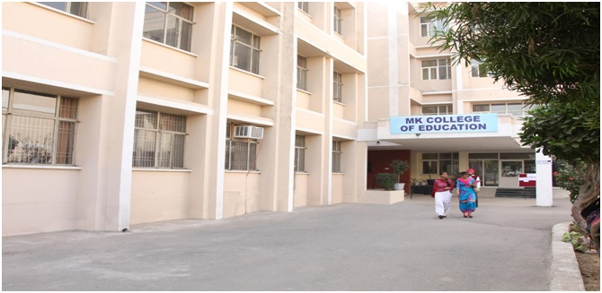
MK COLLEGE OF EDUCATION

Slide 2
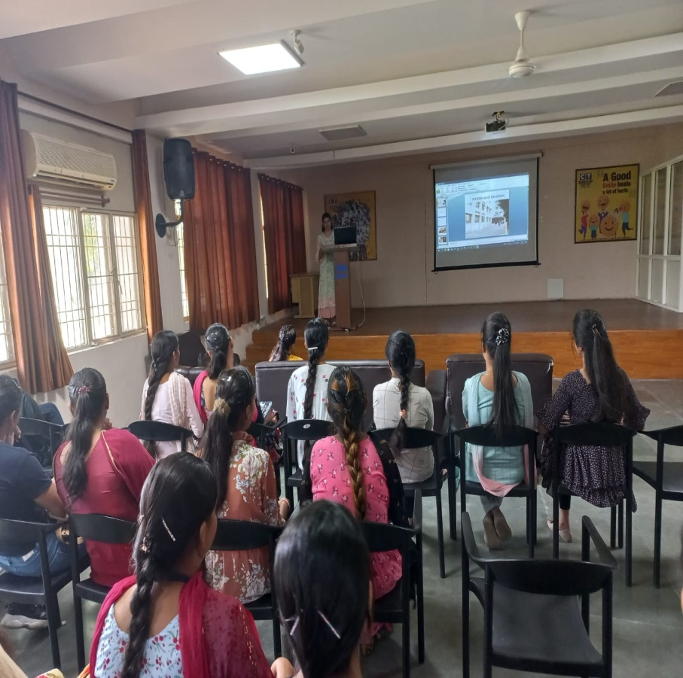
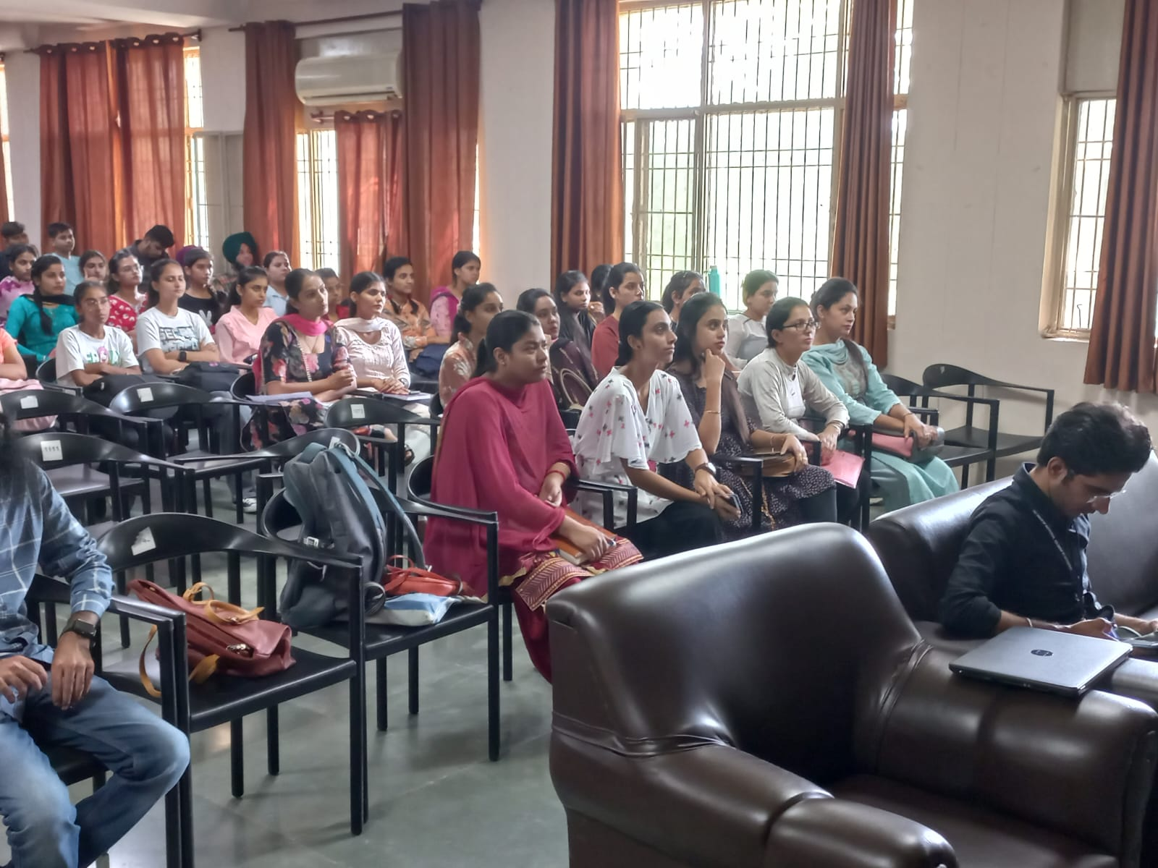
INDUCTION PROGRAMME MK College of Education organized INDUCTION PROGRAME for the commencement of new session of B.Ed. semester-1 . Asst. Prof Ramandeep Kaur Jammu presents the curriculum of B.Ed. Sem-1 in detail. All the curricular and in house activities were displayed and explained to the students. Information about management and all faculty members of the college were introduced to the students in the induction program.

Slide 3
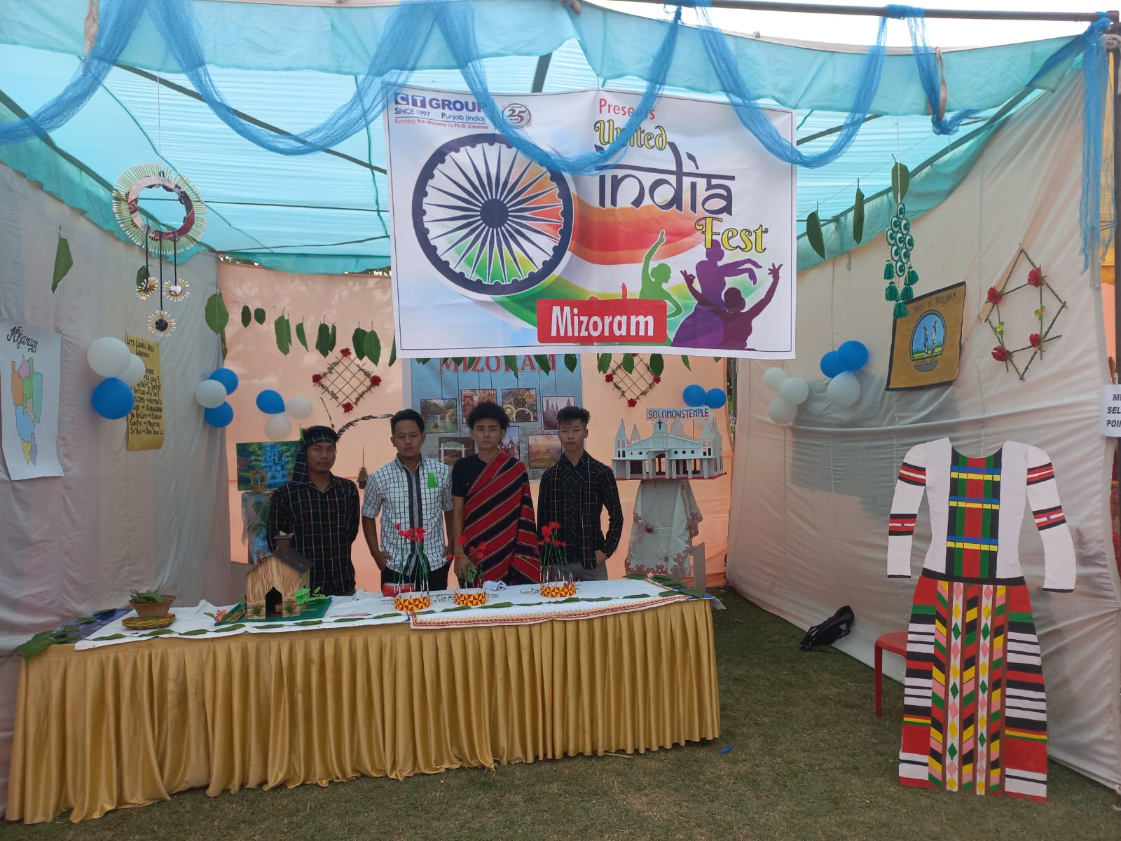
UNITED INDIA FEST

Slide 4
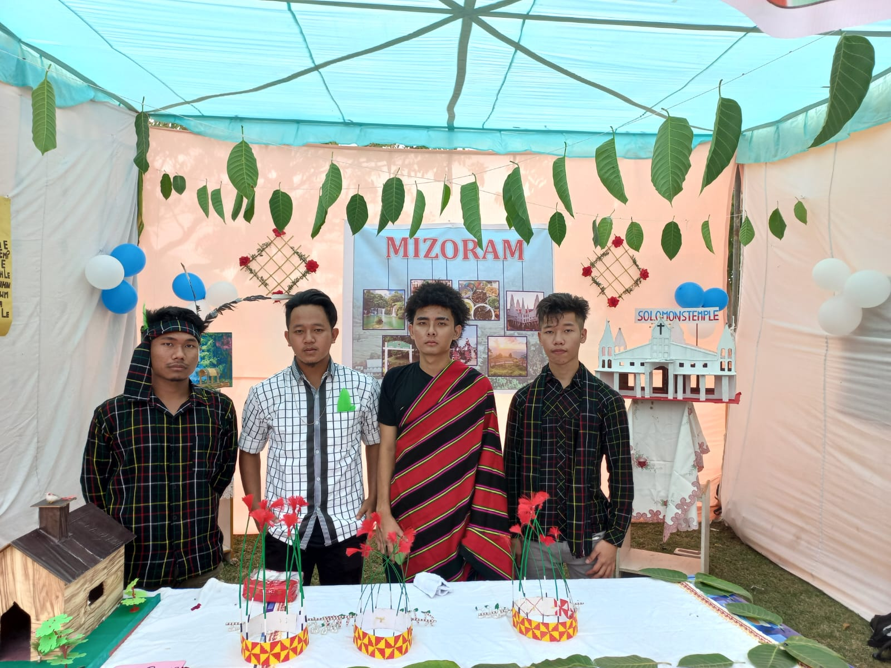

Slide 5
The spirit of unity and diversity flourished at the United India Fest, where our institution proudly represented the vibrant state of Mizoram. The event showcased a splendid fusion of culture and infrastructure, capturing the essence of Mizoram's rich heritage. Elaborate displays highlighted traditional art, dance, and customs, providing a glimpse into the state's unique identity. Our representation not only celebrated Mizoram's distinctiveness but also strengthened the bond of unity among diverse cultures at the United Fest.

Slide 6
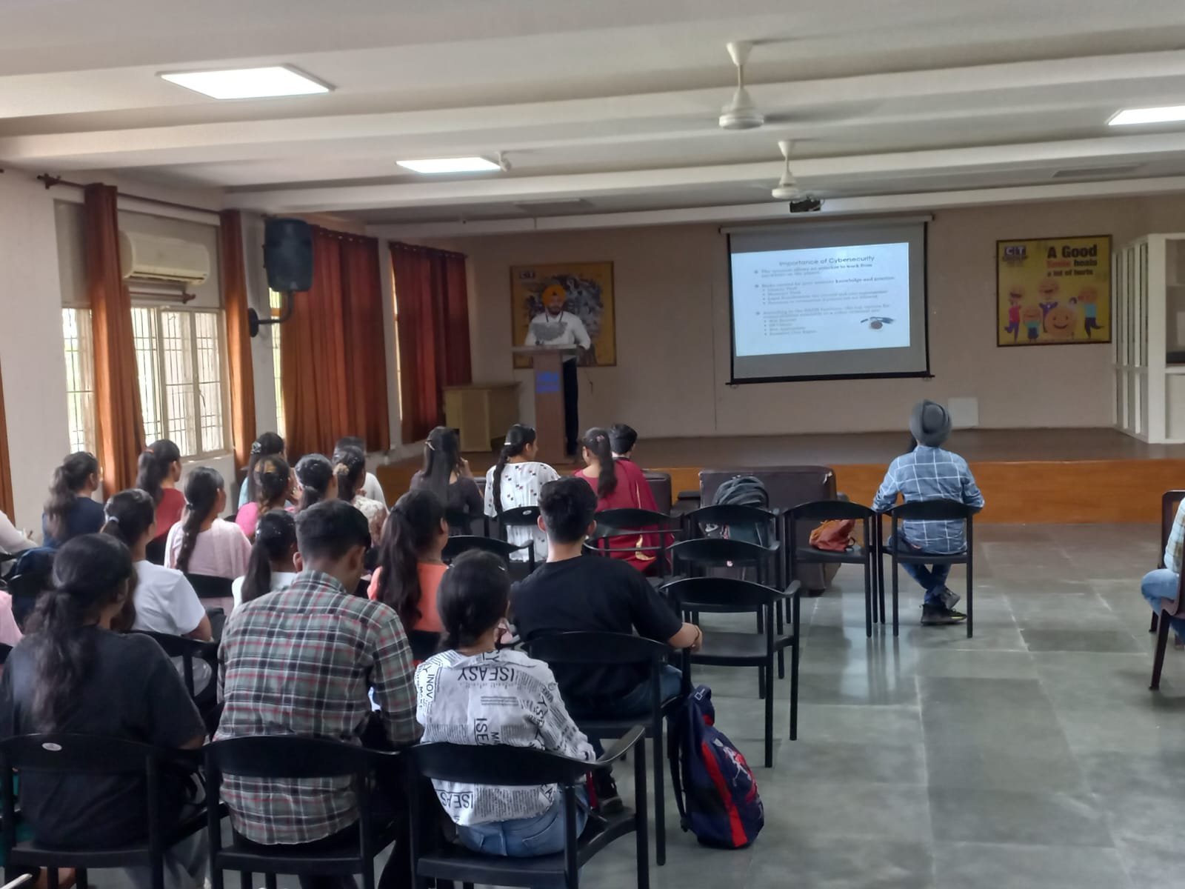
SEMINAR- CYBER CRIME 11th October

Slide 7
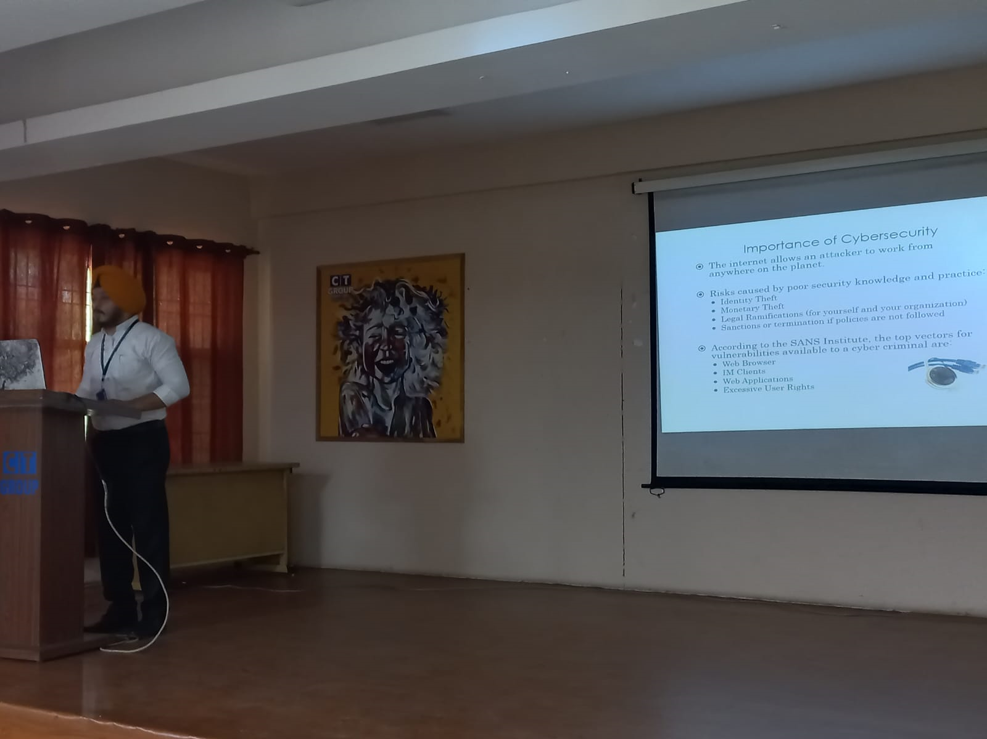
SEMINAR ON CYBER CRIME MK College of Education organized a Seminar CYBER CRIME on 11th Oct.,2022 for all students of B.ED. and D.El.Ed. classes. Asst. Prof Mr. Virat Rehani hosted the seminar and gives a glance of cybercrime and its drawbacks. He gives a clear picture of cyber security and how it affects software users. All faculty members of MK College of Education avail the opportunity to get to know the pros and cons of social sites. Vice Principal- Dr. Kamini Sehgal gives acknowledgement to the resource person for sharing such valuable information among students.

Slide 8
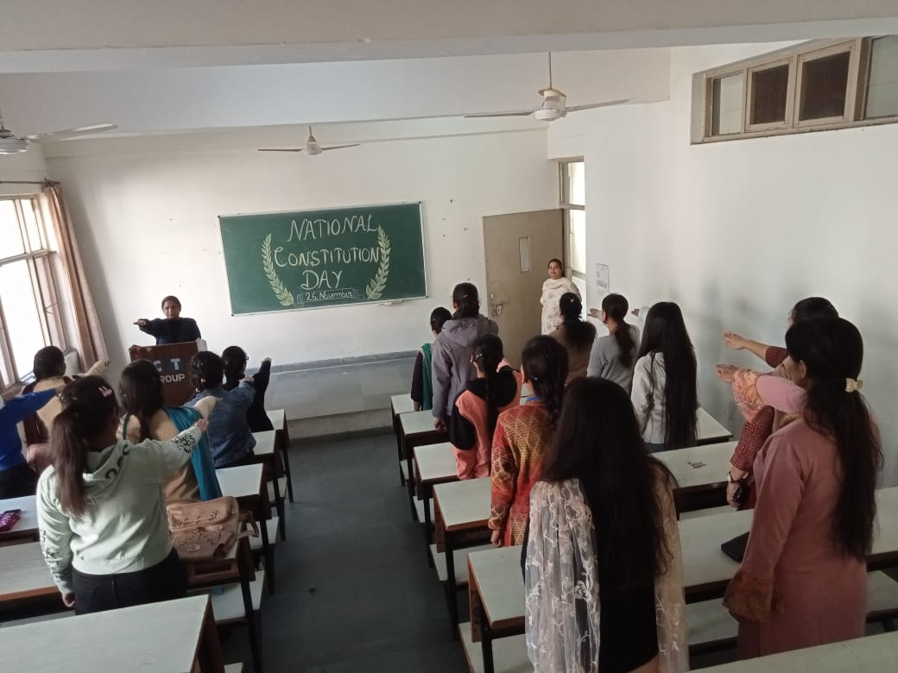
National Constitution Day Students and faculty members of MK College of Education taken the pledge on 26th Nov.,2022 for celebration of National Constitution Day.

Slide 9
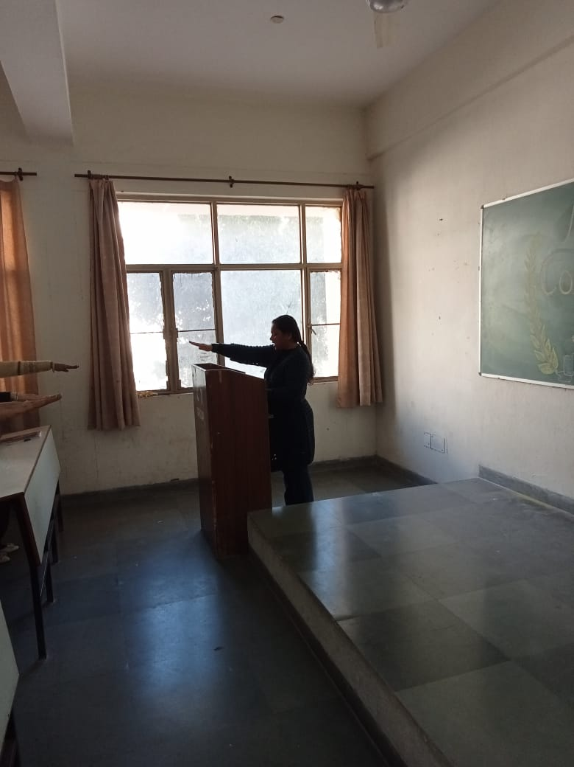
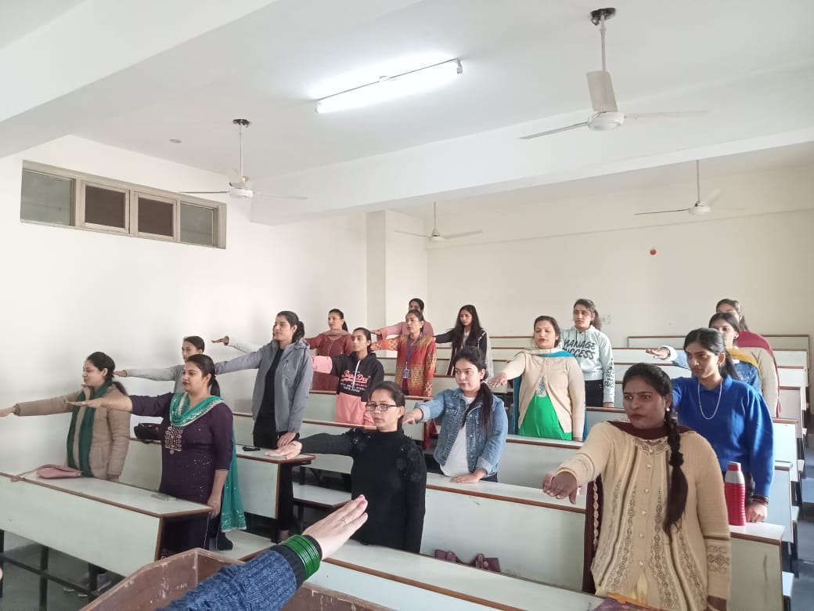
A pledge was taken by students as “WE, THE PEOPLE OF INDIA, having solemnly resolved to constitute India into a SOVEREIGN, SOCIALIST, SECULAR DEMOCRATIC REPUBLIC and to secure to all its citizens: JUSTICE, social, economic and political; LIBERTY of thought, expression, belief, faith and worship; EQUALITY of status and of opportunity; and to promote among them all FRATERNITY assuring the dignity of the individual and the unity and integrity of the Nation; IN OUR CONSTITUENT ASSEMBLY this twenty-sixth day of November, 1949, do HEREBY ADOPT, ENACT AND GIVE TO OURSELVES THIS CONSTITUTION.

Slide 10
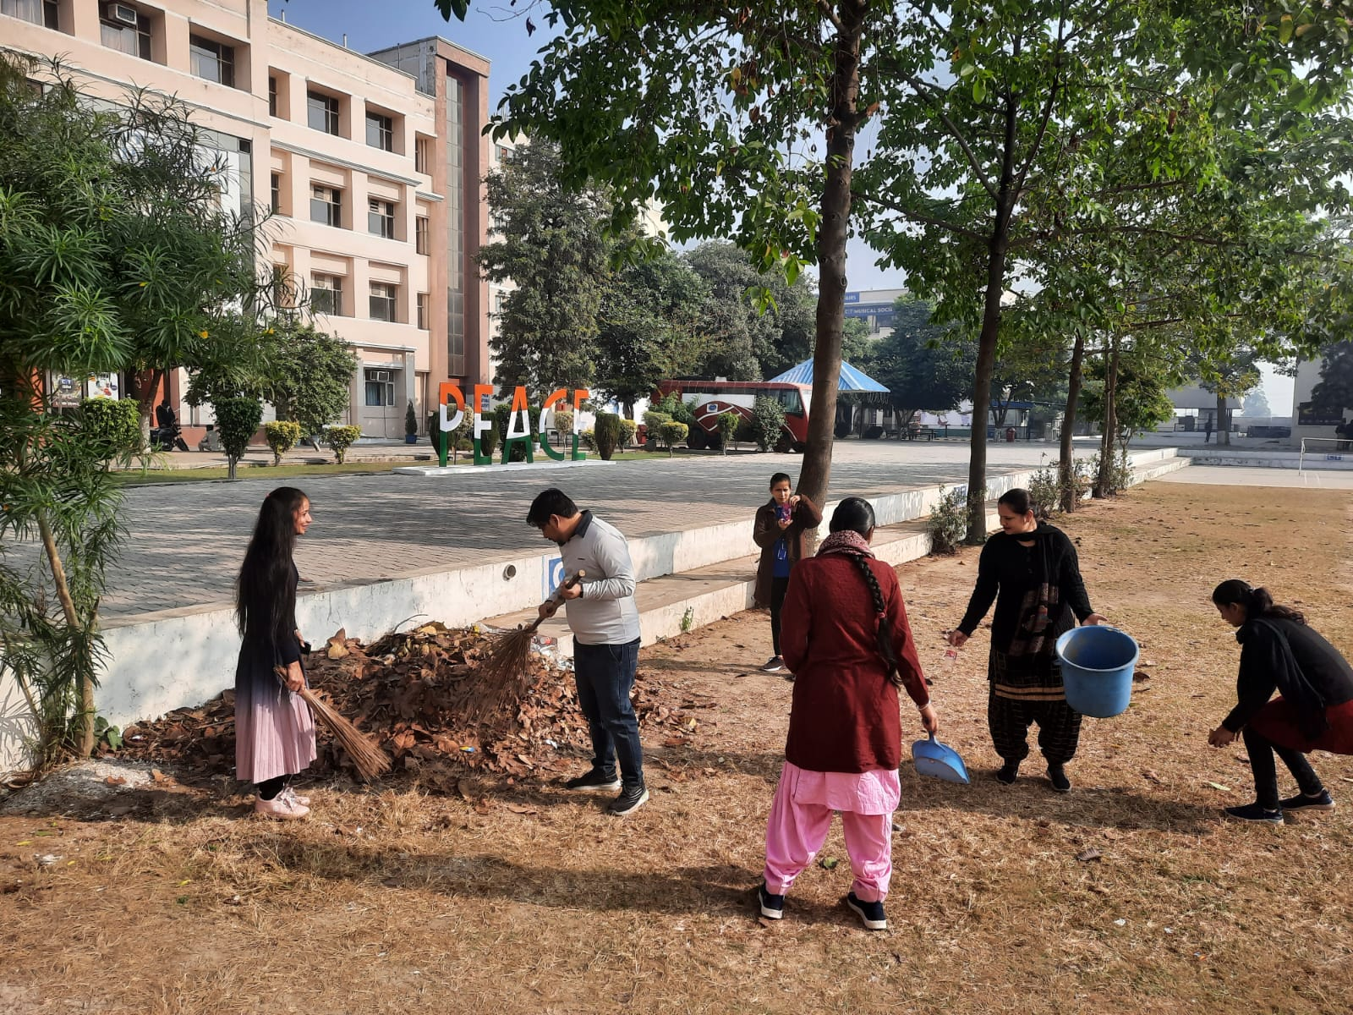
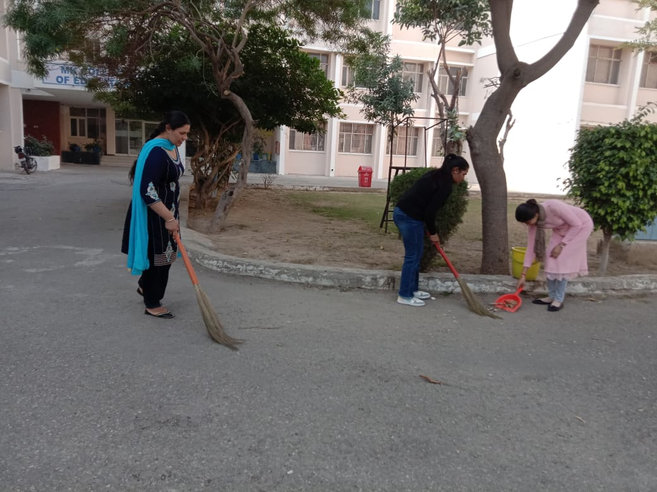
CAMPUS CLEANINESS

Slide 11
M.K. College of Education organized a campus cleaning campaign, drawing enthusiastic participation from its B.Ed. students. The initiative aimed to cultivate a sense of responsibility and community spirit. Activities included trash pickup, indoor cleaning, gardening, and awareness sessions on cleanliness. The event not only enhanced the campus's physical appearance but also nurtured valuable life skills among the participating students. Their active involvement showcased a commitment to maintaining a healthy and vibrant learning environment.

Slide 12
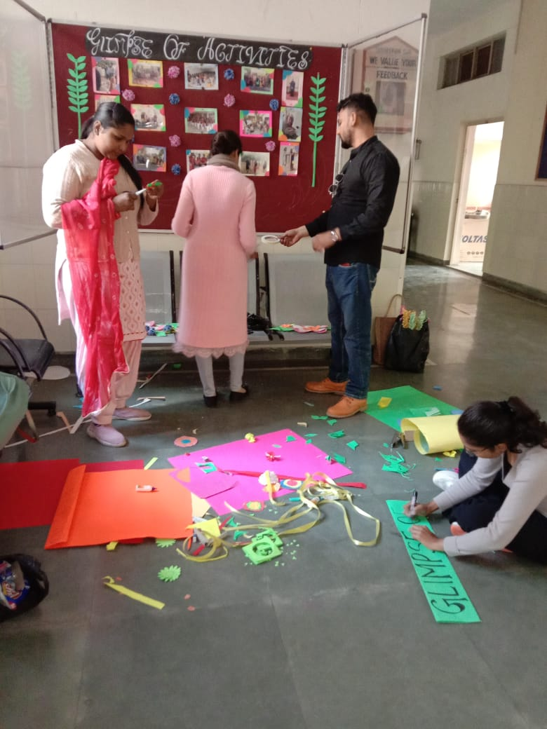
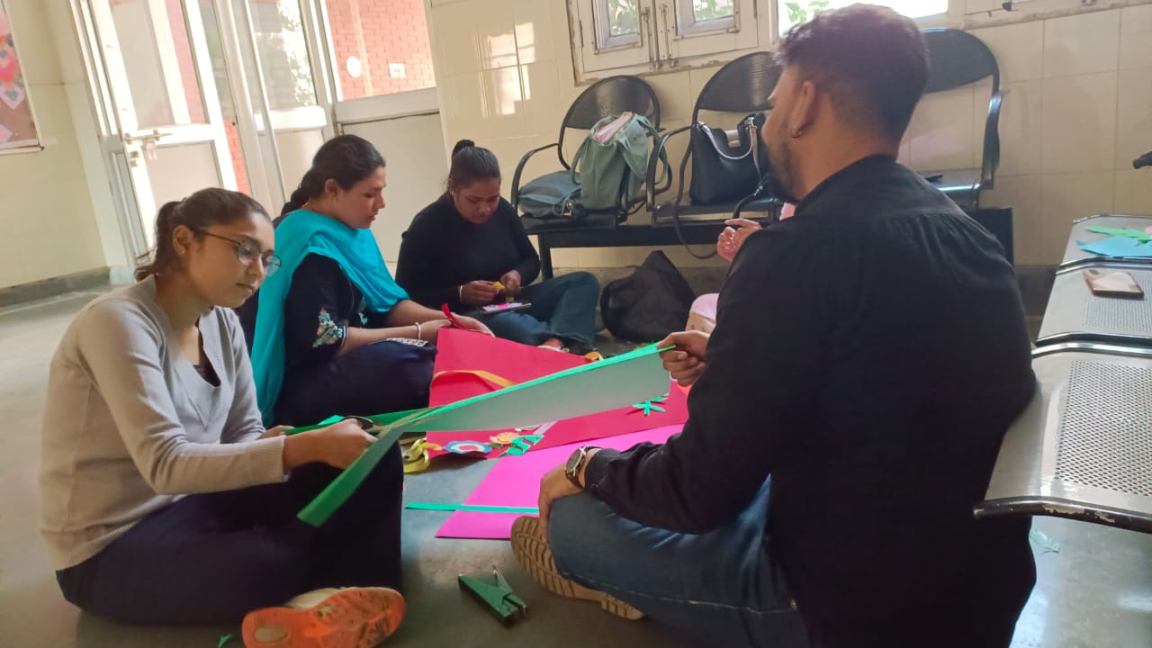
CAMPUS BEAUTIFICATION

Slide 13
M.K. College of Education underwent a transformative campus beautification project, featuring active engagement from B.Ed. and D.El.Ed. students. Their collective efforts encompassed planting, cleaning, and enhancing green spaces, fostering a visually appealing and conducive learning environment. The collaborative initiative showcased the students' dedication to uplifting their educational surroundings and promoting a sense of pride within the M.K. College community.

Slide 14
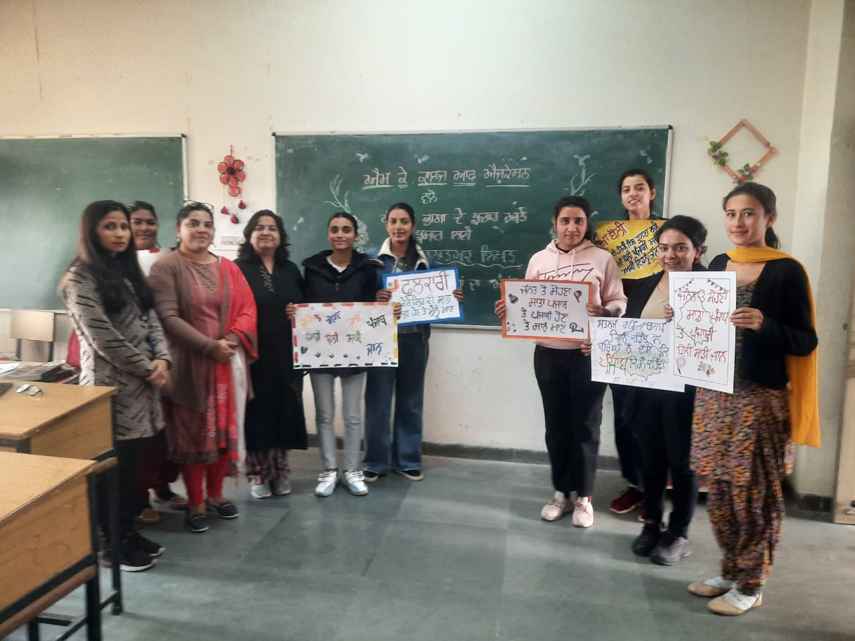
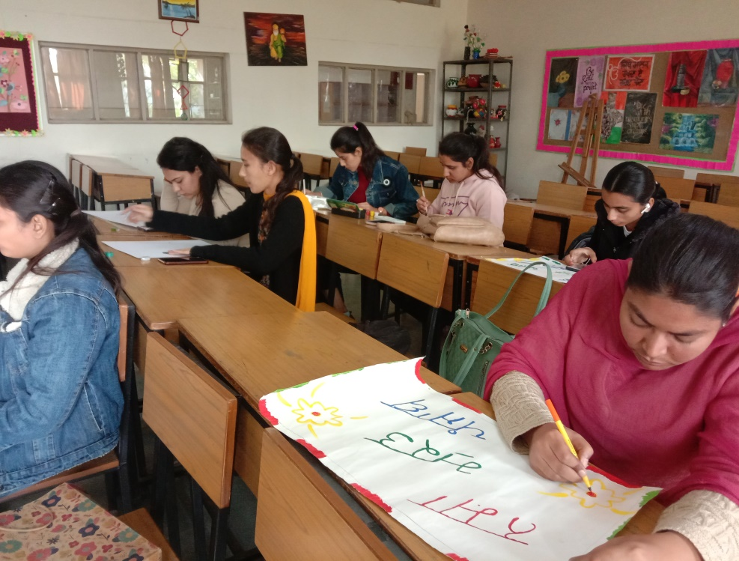
Punjabi Month

Slide 15
The celebration of the Punjabi Month at our institution was a vibrant and culturally enriching event. Participants, including students, faculty, and staff, joined in various activities that highlighted the rich heritage of Punjab. The festivities included poster making on traditional music, dance performances, and insightful talks on Punjabi literature. This celebration not only fostered a deeper appreciation for our cultural roots but also strengthened the sense of unity and diversity within our educational community.

Slide 16
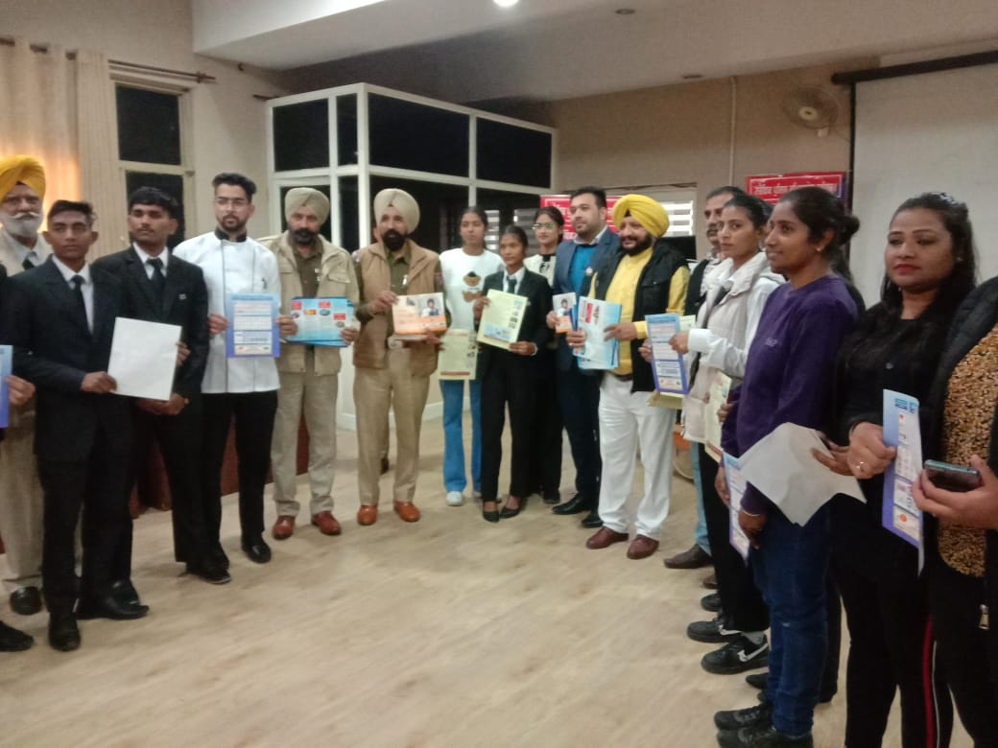
ROAD SAFETY SEMINAR
The recent Road Safety Seminar hosted by our institution aimed at raising awareness and promoting responsible practices on the road. Engaging speakers covered topics such as defensive driving, traffic rules, and the importance of wearing seat belts. Interactive sessions and simulations provided practical insights. The seminar underscored our commitment to cultivating a culture of safety, emphasizing the pivotal role each individual plays in ensuring road well-being for all.

Slide 17
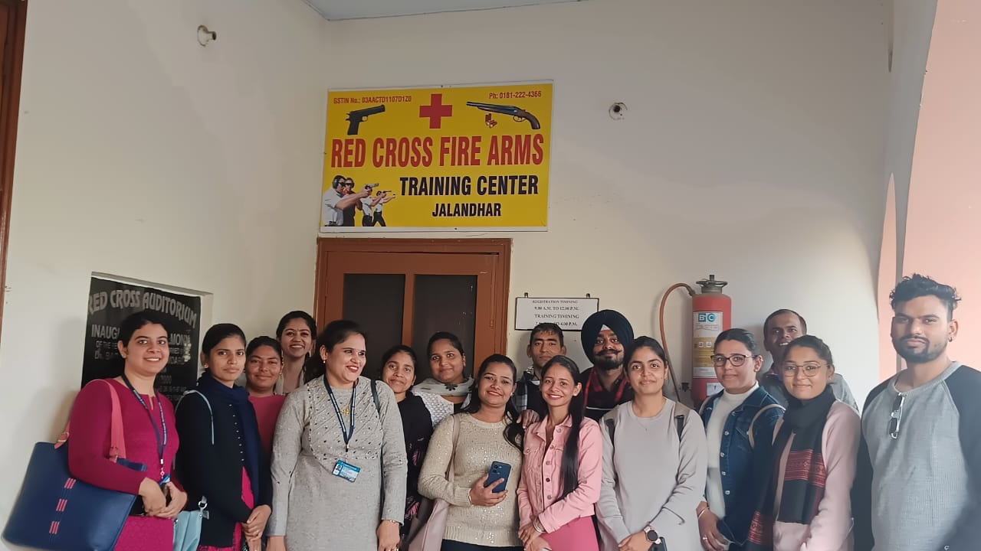
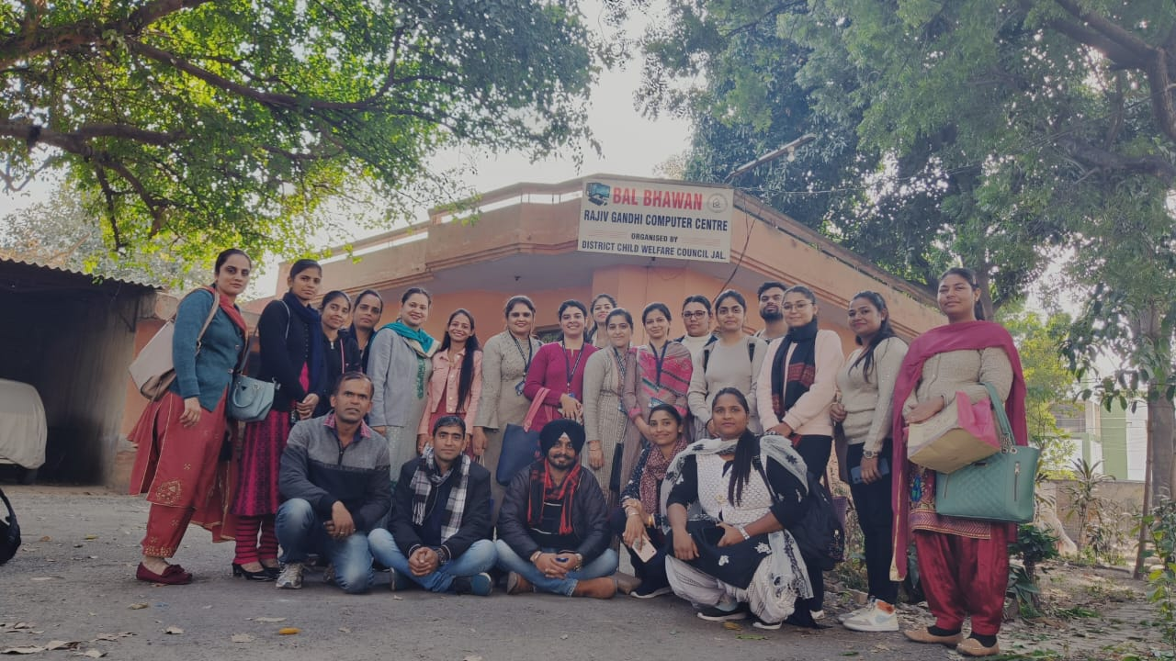
Visit to Red Cross Bhawan

Slide 18
A visit to Red Cross Bhawan was organized for the B.Ed. And D.El.Ed. Students. The informative tour showcased the diverse initiatives undertaken, from disaster relief to blood donation drives. Engaging with dedicated volunteers and witnessing their training emphasized the vital role the Red Cross plays in community welfare. This visit not only deepened the understanding of humanitarian work but also inspired a renewed commitment to contributing to the well-being of society.

Slide 19
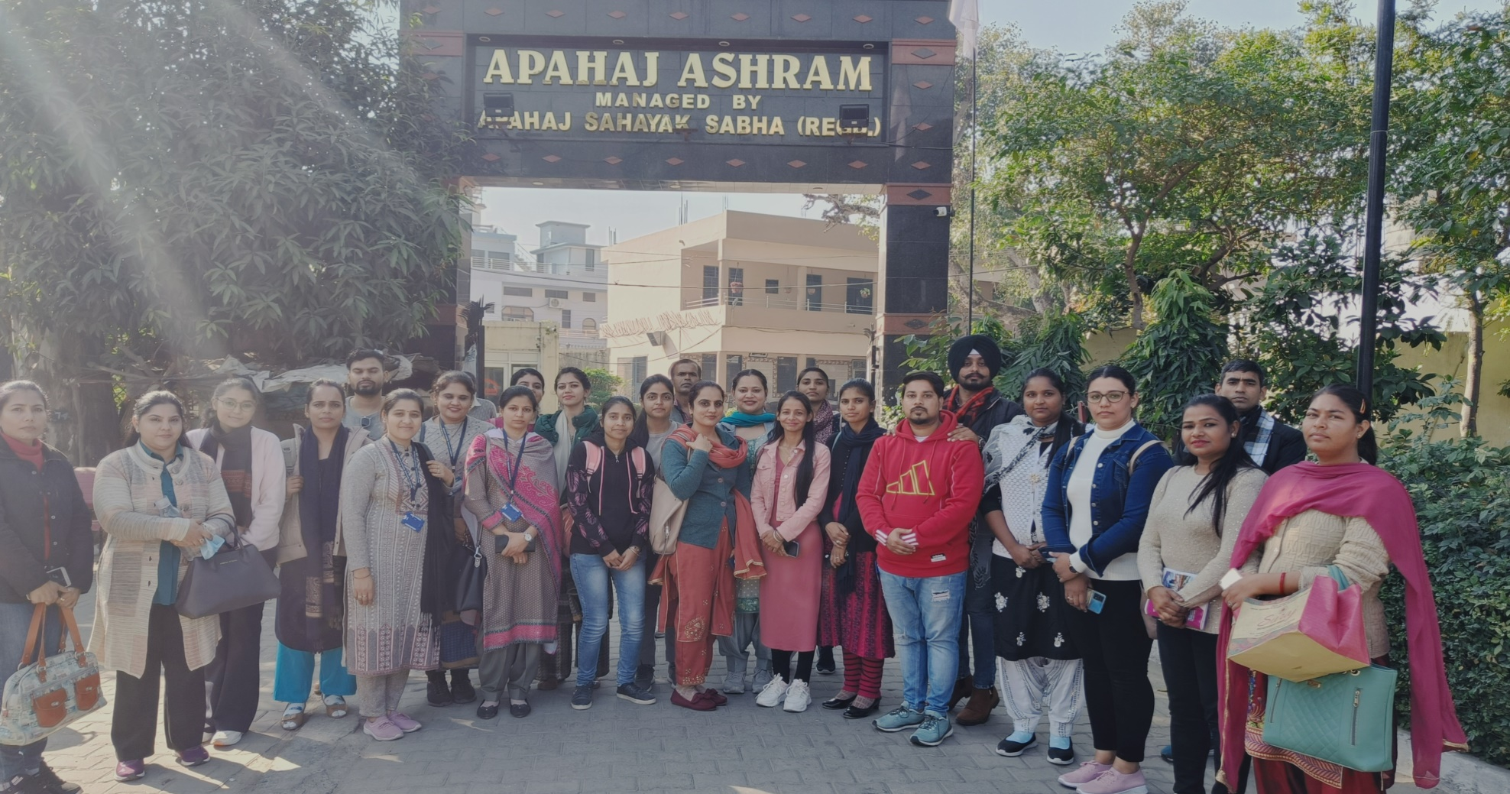
Visit To Apahaj Ashram MK COLLEGE OF EDUCATION organized a visit to Old Age Home for B.Ed. Semester 1 students as their curriculum activity. It was arranged to acknowledge the students for community service to abandoned and neglected senior citizens and learnt about true life, sharing and caring. With this visit they were able to understand to treat them with respect and dignity. They spend time with them, listen their personal stories. In order to share a token of love with them some students distribute woolen clothes, caps and socks to them. Students also serve fruits to them.

Slide 20
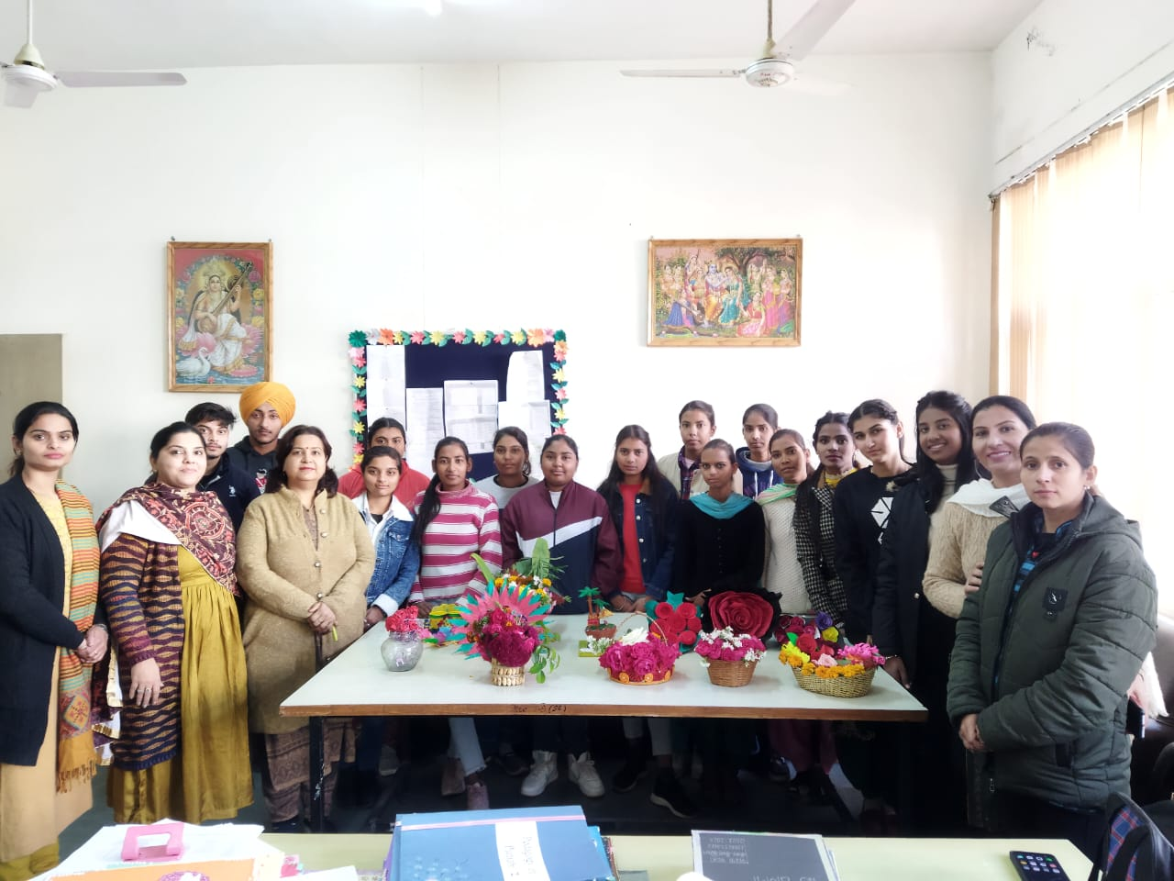
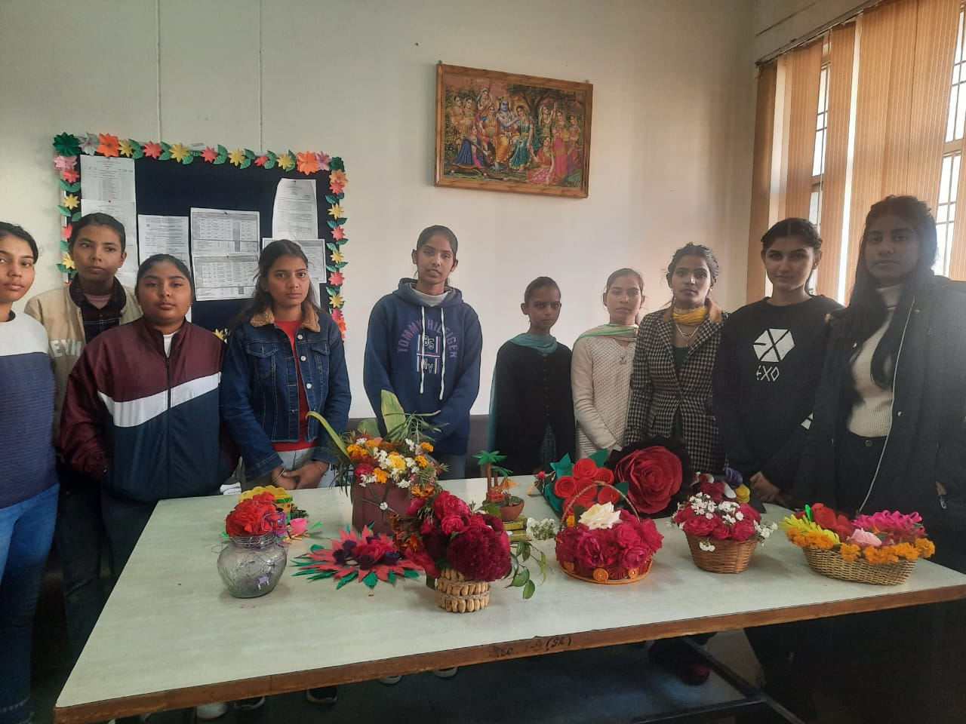
Flower Arrangement Activity
Flower Arrangement activity was organized on Basant Panchmi .Students arrange different colorful flowers in pots, buckets, bouquets, bunches etc. All D.El.Ed and B.Ed students enthusiastically participated in this activity. Vice Principal Dr. Kamini Sehgal and all faculty members cheer up the students for such wonderful creativity. Dr. Kamini Sehgal appreciate the work done by students and motivate them for future activities.

Slide 21
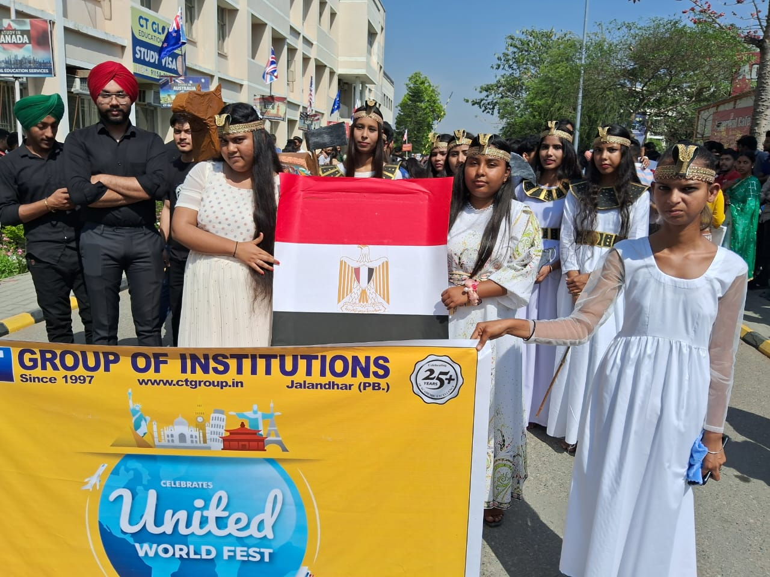
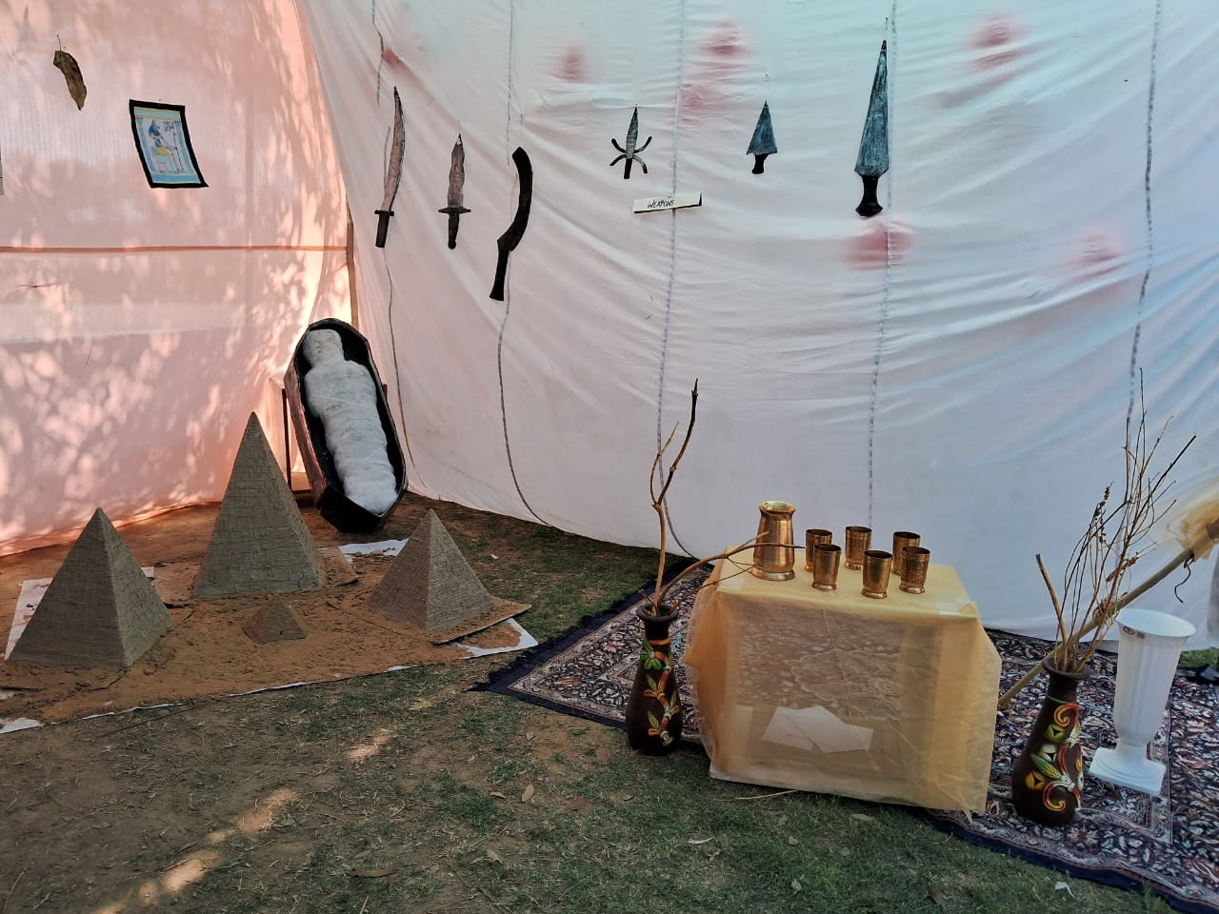
United World Fest-2023
“Unity is strength …….. where there is unity is always victory”
United World Fest was organized in the campus . The students of M.K. College of Education represented the country “Egypt” .They displayed different models of famous pyramids ,tools, food ,symbols of Egypt.

Slide 22
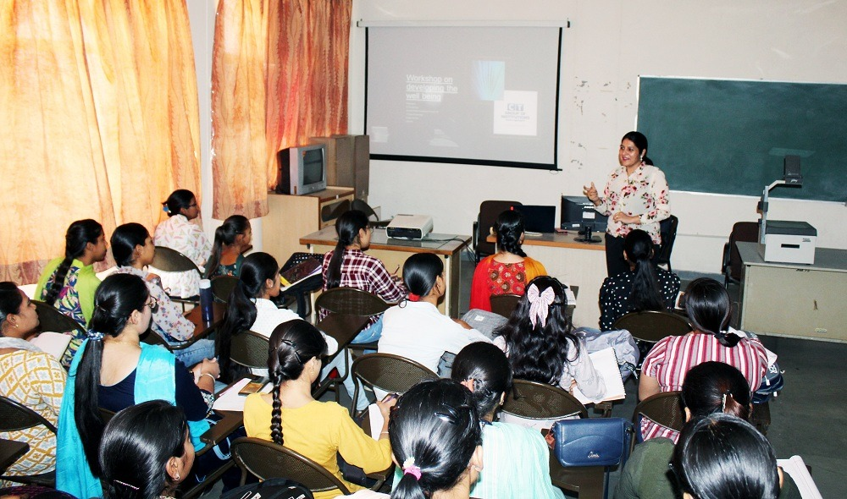
Workshop on “Developing Well Being”
MK College of Education organised workshop on “Developing Well being” in ICT Resource Centre. The guest speaker Dr. Sharnjit Kaur enlightened the students for personality grooming ,mental health and define themselves to be well beings. Vice-principal Dr. Kamini Sehgal gave vote of thanks to esteemed speaker.

Slide 23
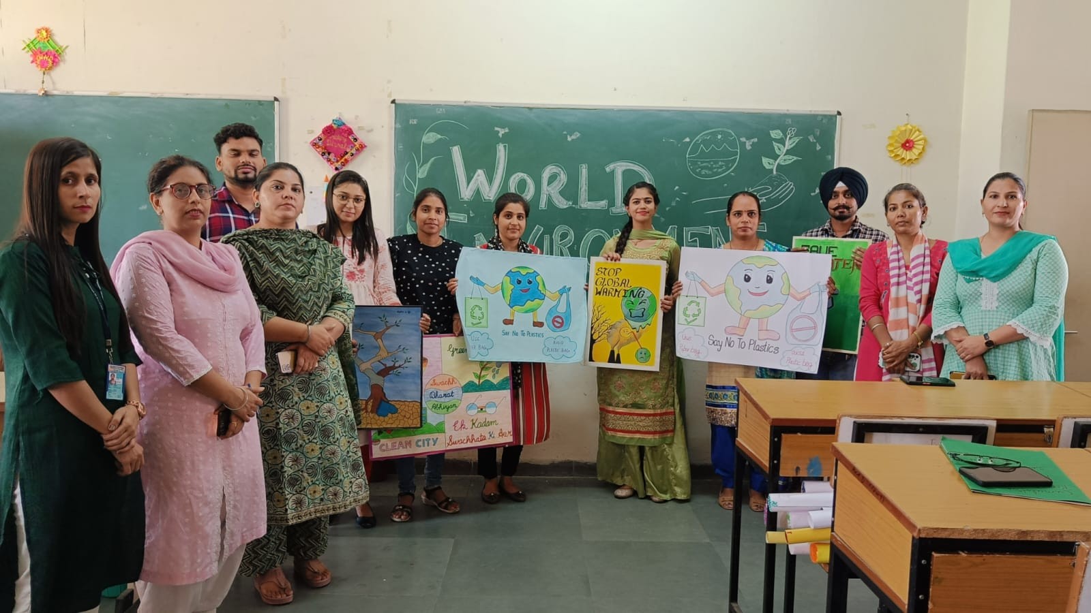
Environment Day
M K COLLEGE of Education has organized world environment day activity . Students of B.Ed (Sem-II and Sem-IV) class participated in poster making activity .They artistically paint their ideas to make people aware of such issues like less use of plastic , clean surroundings , save water and plant more trees .Our students portrays the themes beautifully to aware society for save environment.

Slide 24
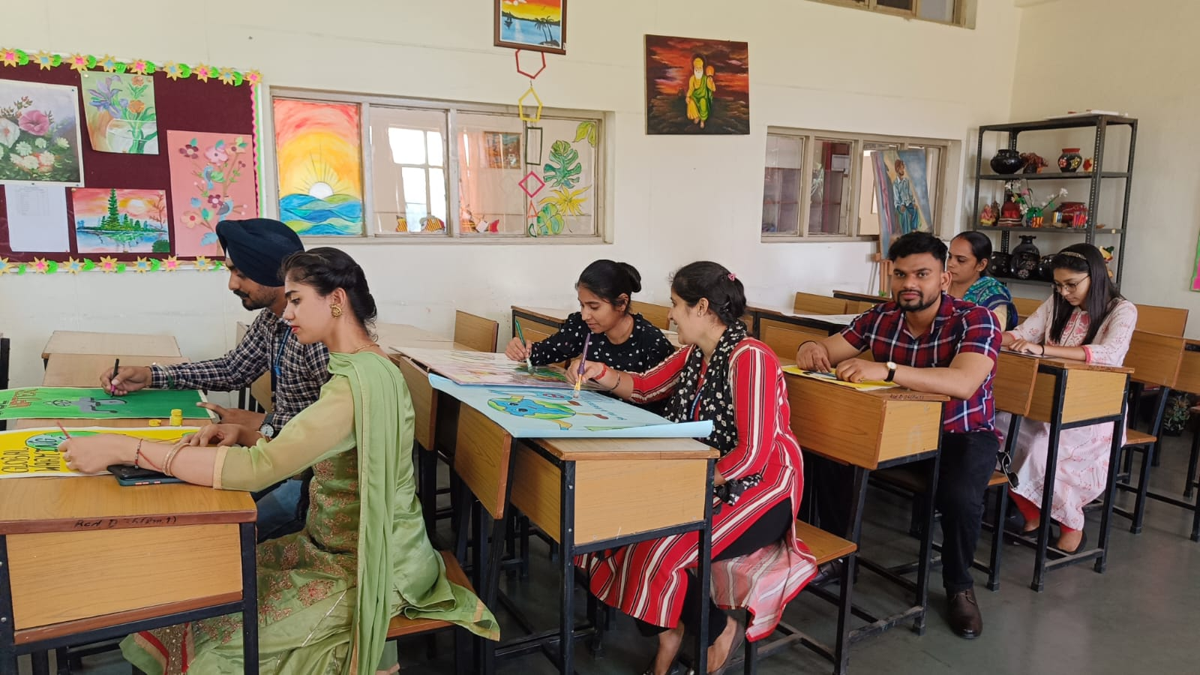
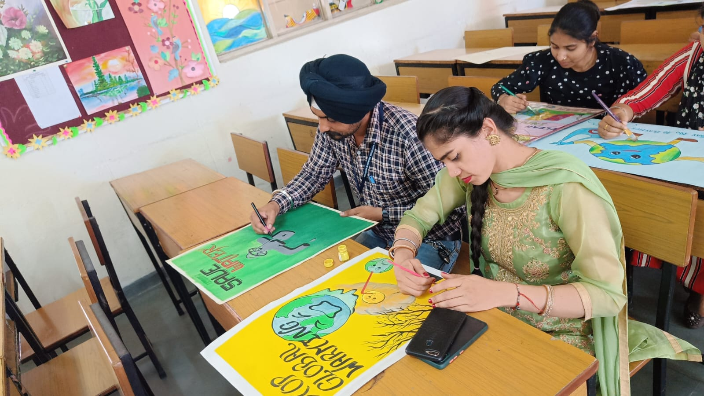

Slide 25
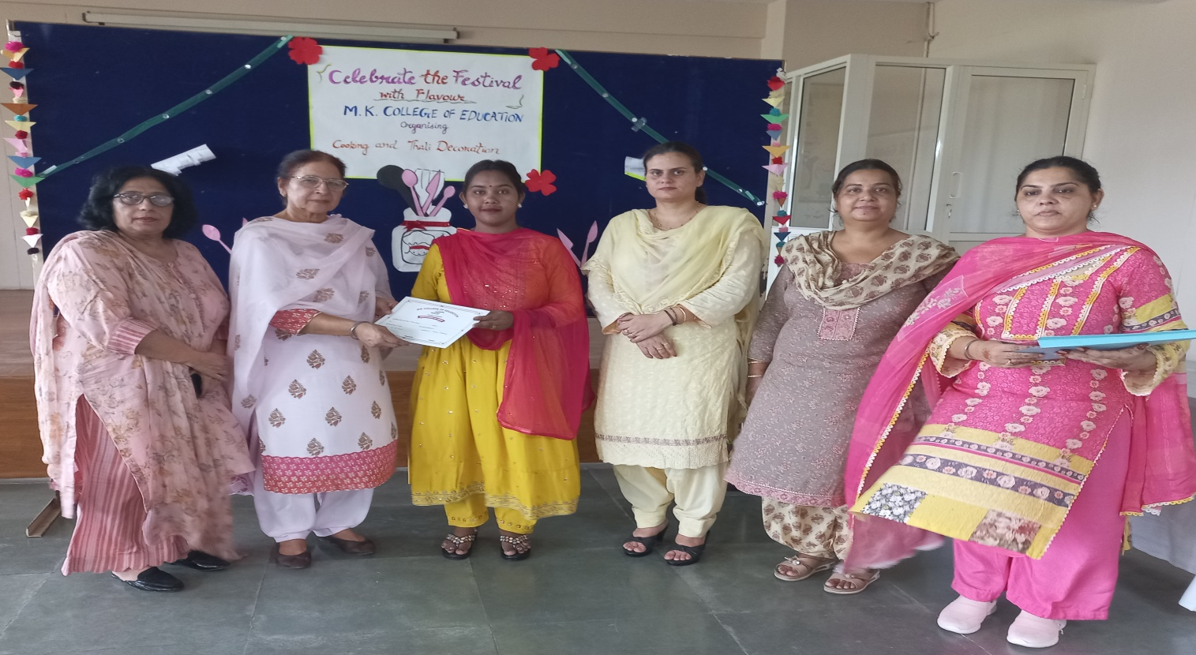
Cooking and Rakhi making Competition

Slide 26
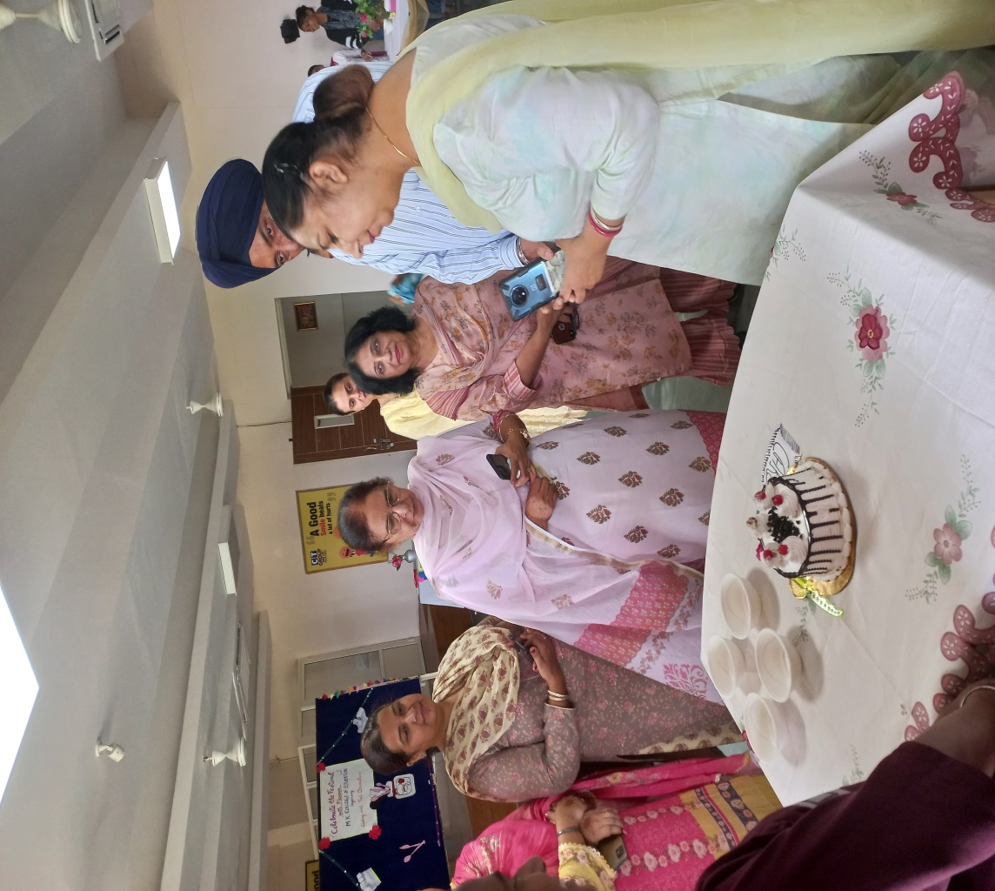

Slide 27
The Cooking and Rakhi Making Competition at M.K. College of Education was a delightful showcase of creativity and culinary skills. Students passionately participated, crafting delectable dishes and intricate Rakhis. The event saw a display of diverse talents, making the judging process both exciting and challenging. Dr. Gurpreet Singh , esteemed Director CT Group of Institutions, Shahpur, Dr. Jasdeep kaur Dhammi, our Director PTU campuses , Dr. Kuldeep Kaur Grewal, our esteemed Director, Vice Principal Dr. Kamini Sehgal provided valuable guidance and encouragement. The winners received well-deserved rewards, fostering a spirit of enthusiasm and camaraderie among the participants.

Slide 28
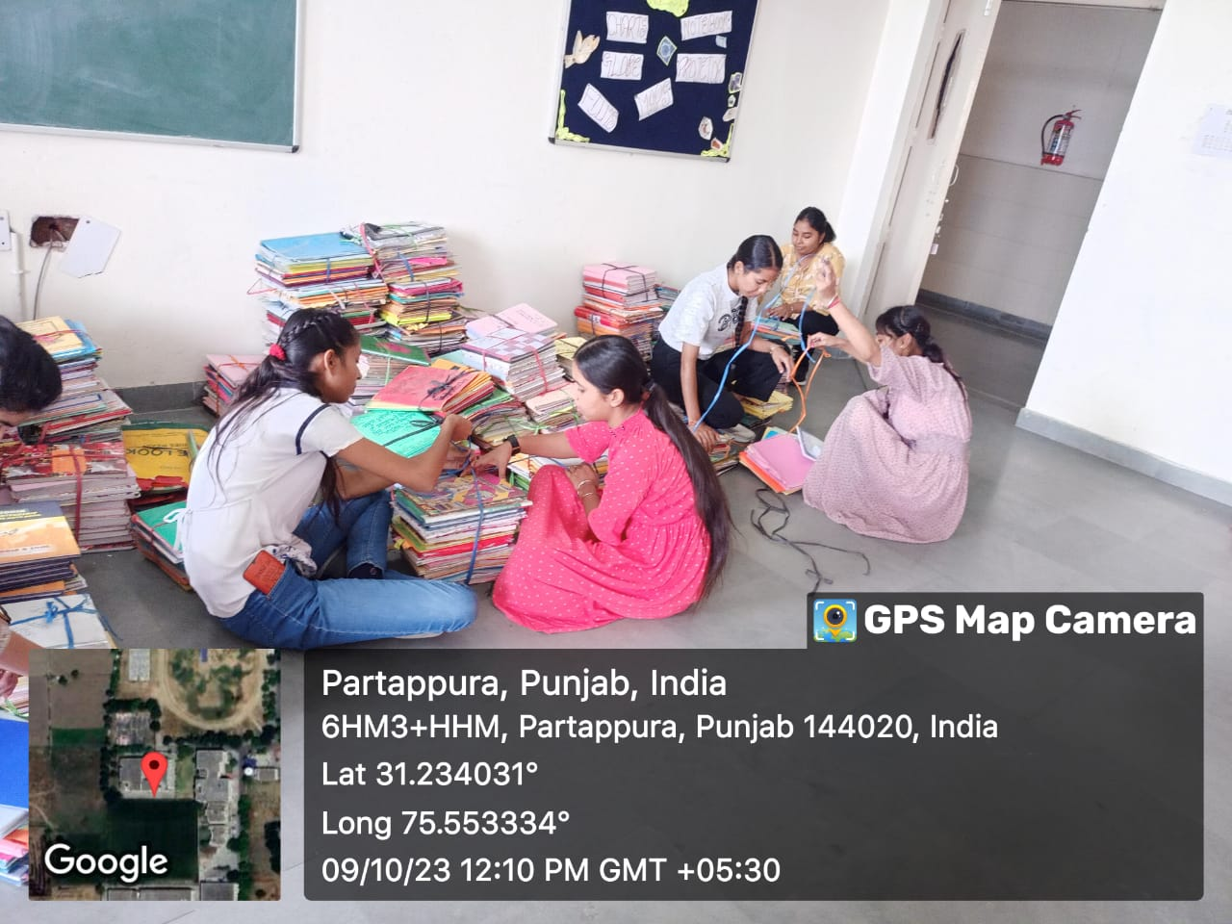
Swachhta Pakhwada

Slide 29
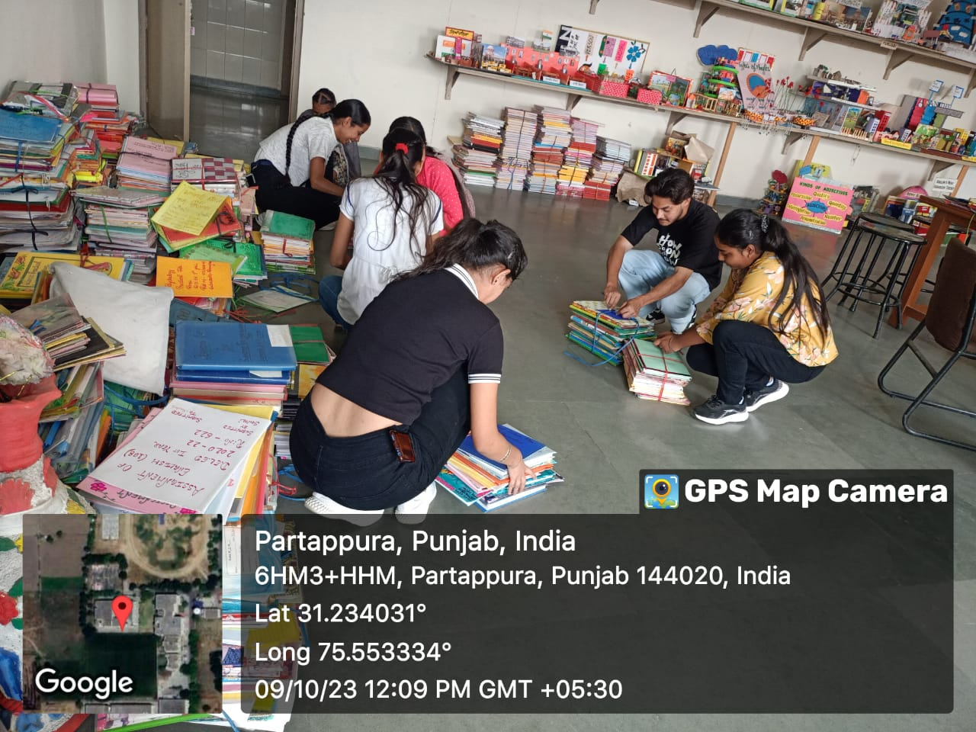

Slide 30
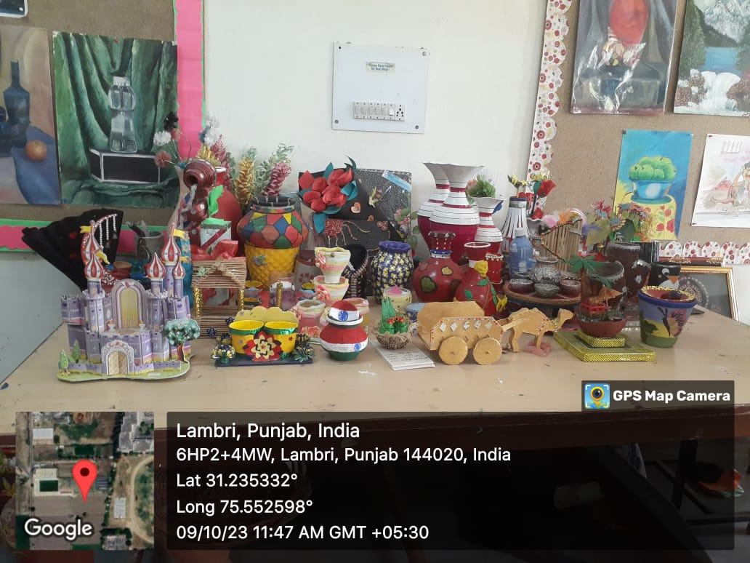
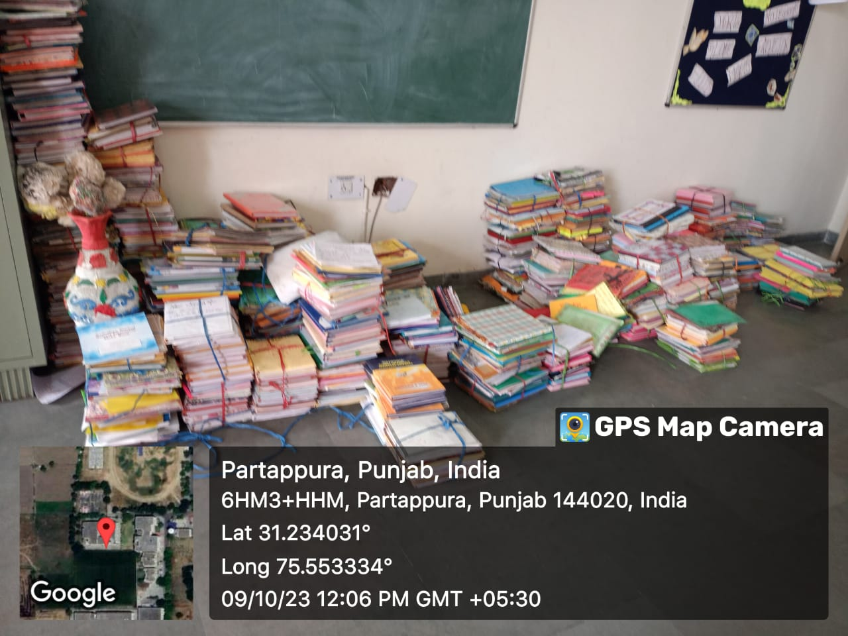
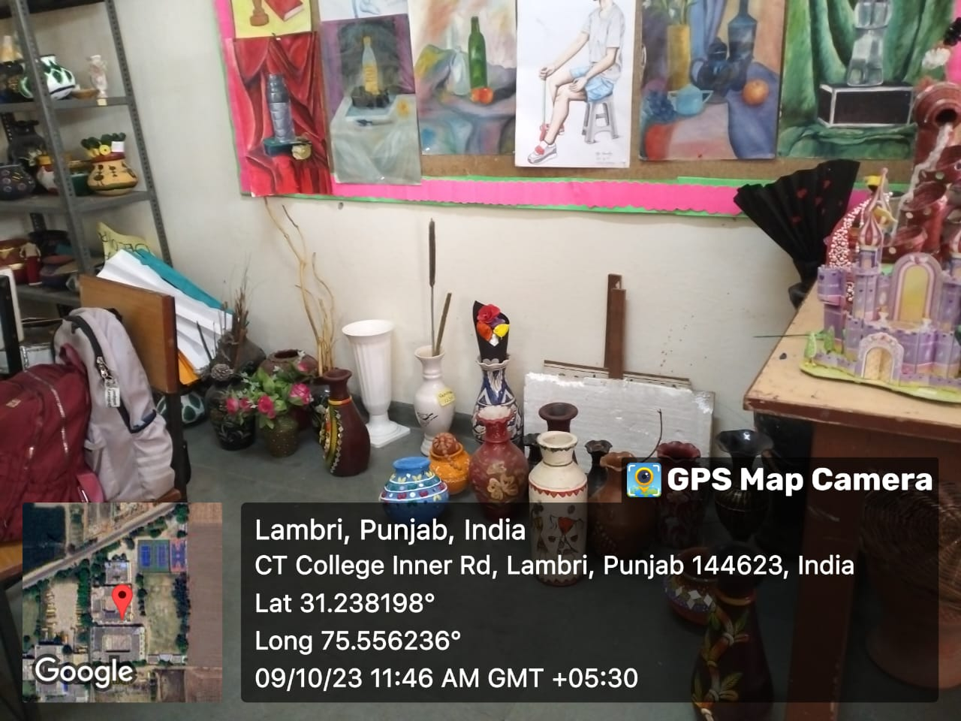

Slide 31
Turning trash into Treasure. M.K. College of Education has organized Swachh Pakwada Special Campaign in the campus. The students of the college transformed their surroundings with creativity and dedication. Our Swachh Pakwada Special Campaign was a roaring success.

Slide 32
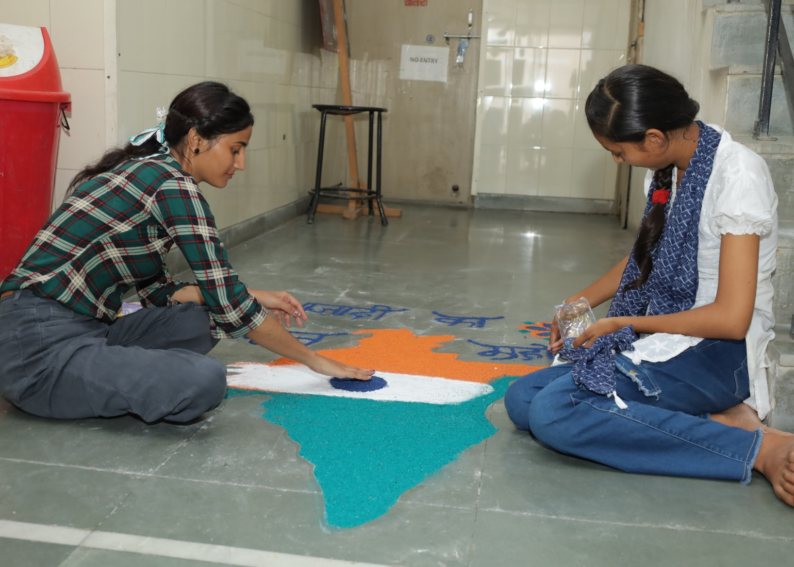
Jashan-E-Azadi

Slide 33
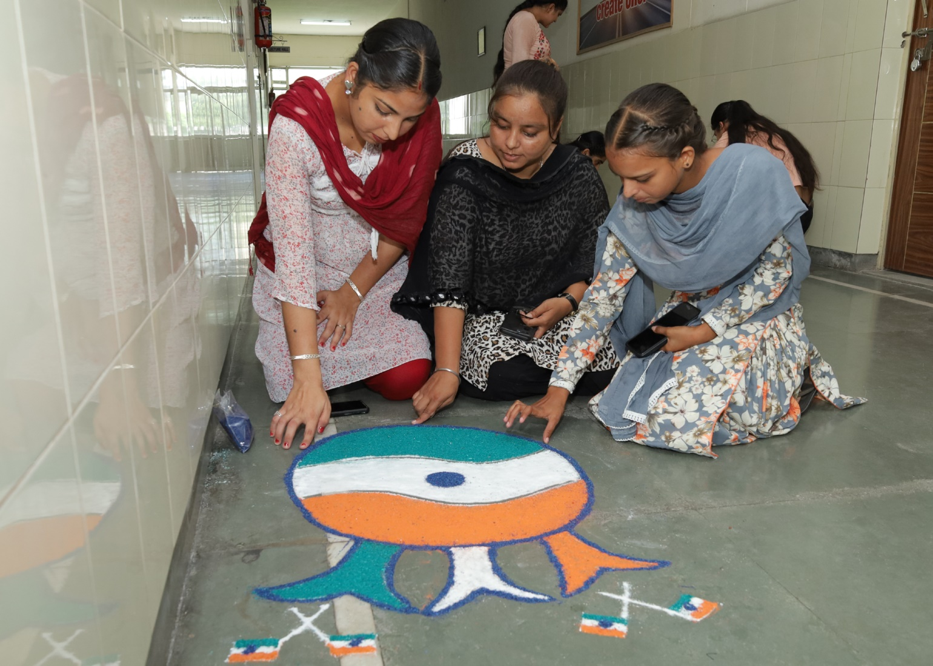

Slide 34
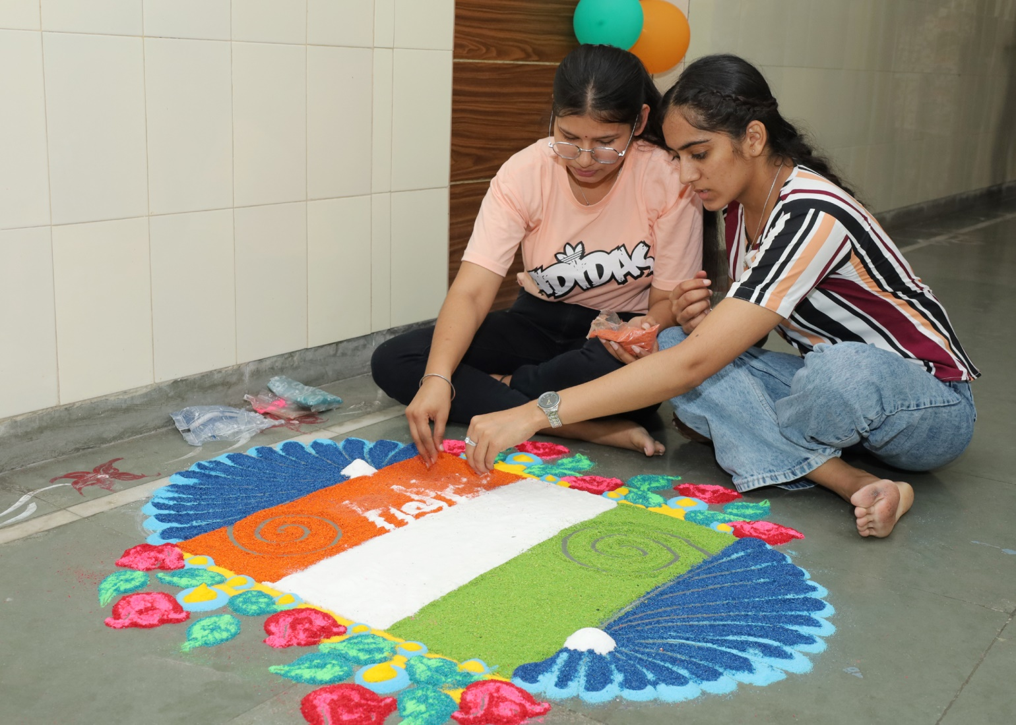

Slide 35
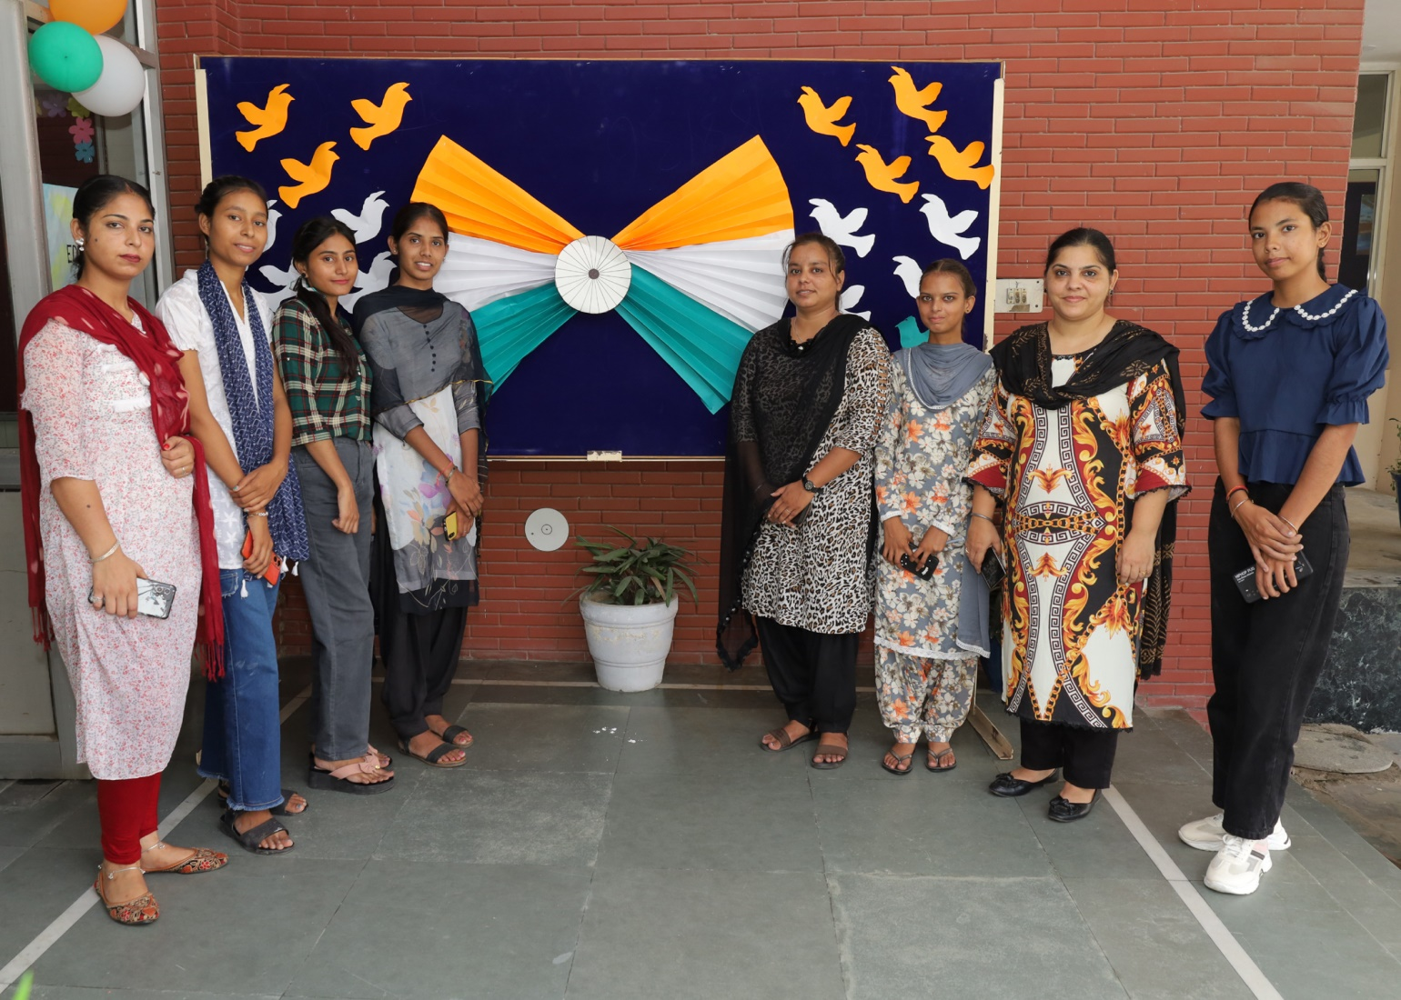

Slide 36
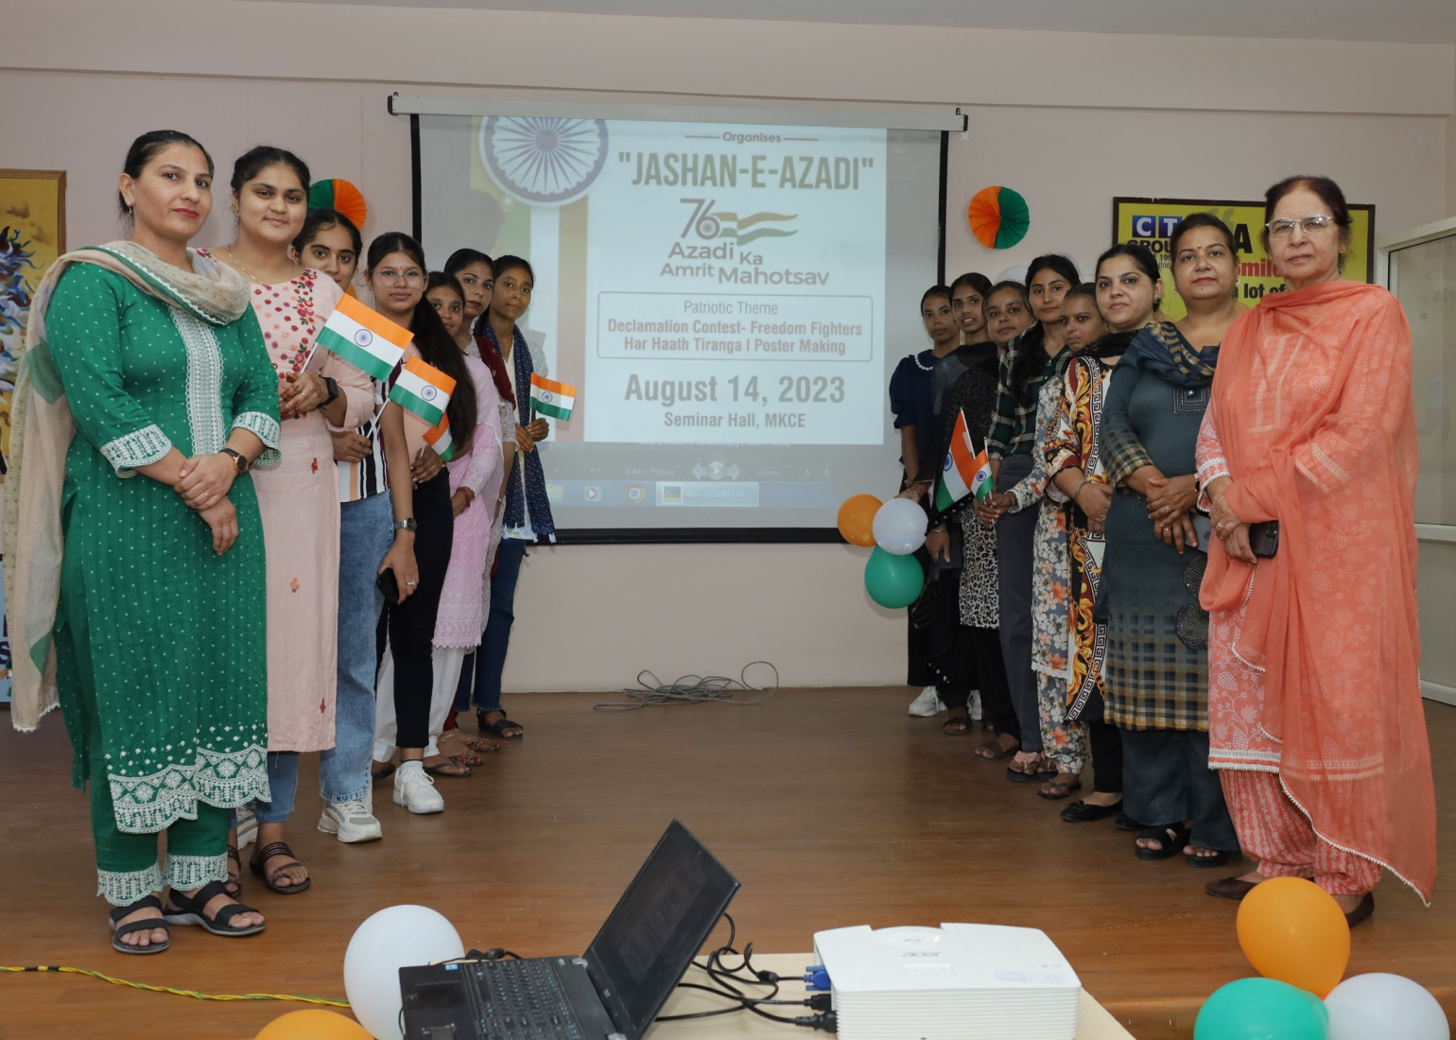

Slide 37
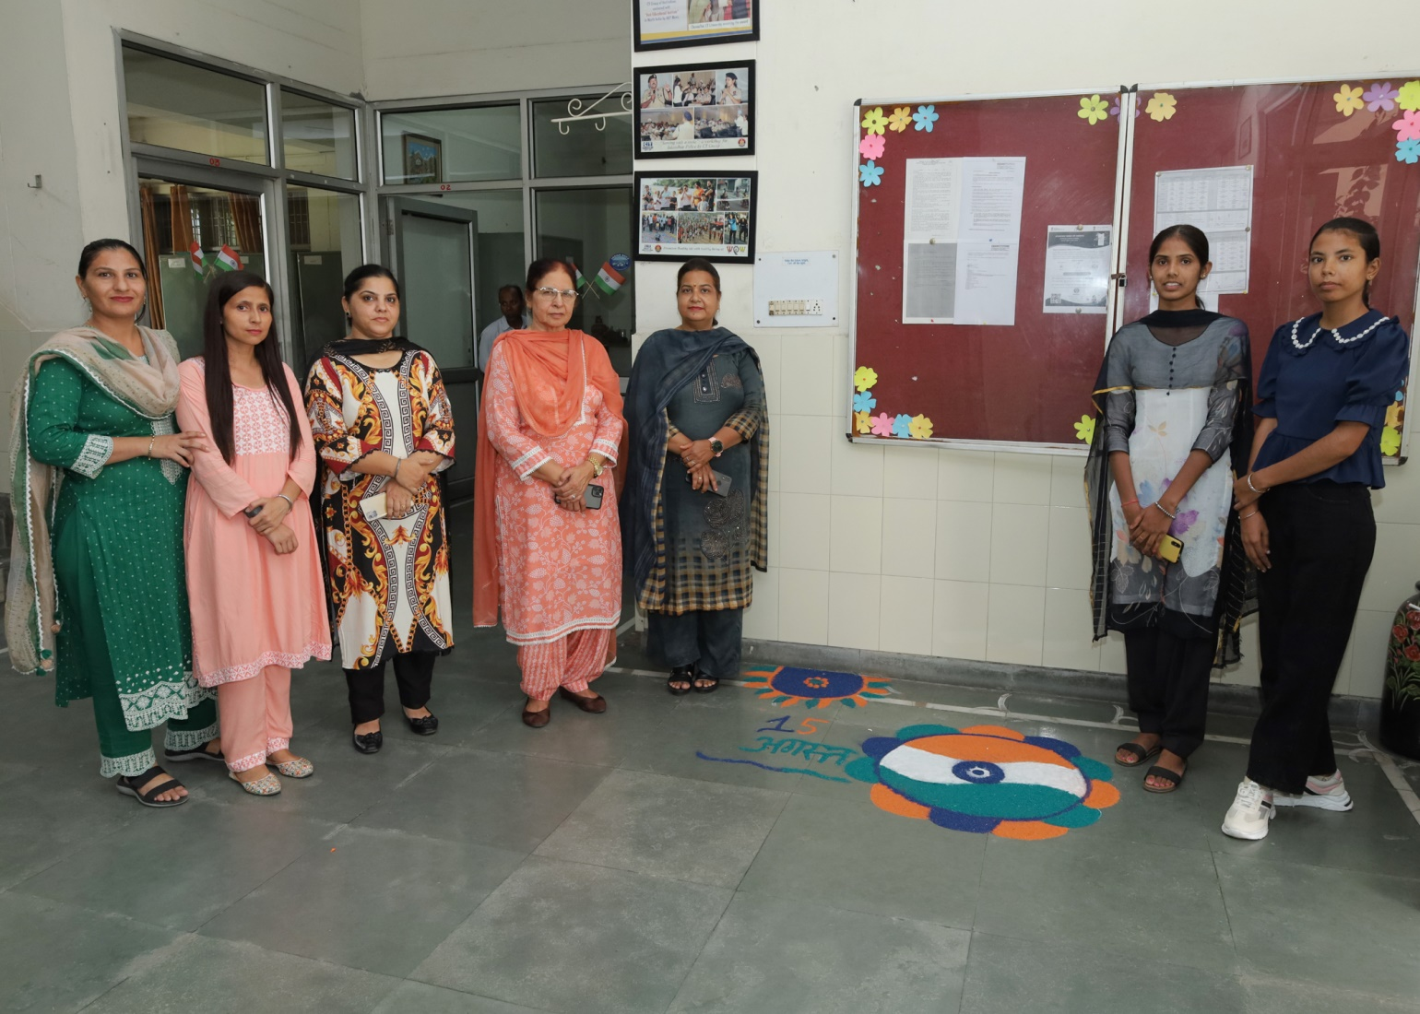

Slide 38
The celebration of Jashne Azadi (Independence Day) at our institution was a patriotic extravaganza, filled with fervor and creativity. Students adorned the campus with vibrant rangolis, depicting the spirit of freedom and unity. Through their artistic expressions, students beautifully captured the essence of independence, contributing to a festive and patriotic atmosphere. The event served as a poignant reminder of our shared commitment to the ideals of freedom and nationhood.

Slide 39
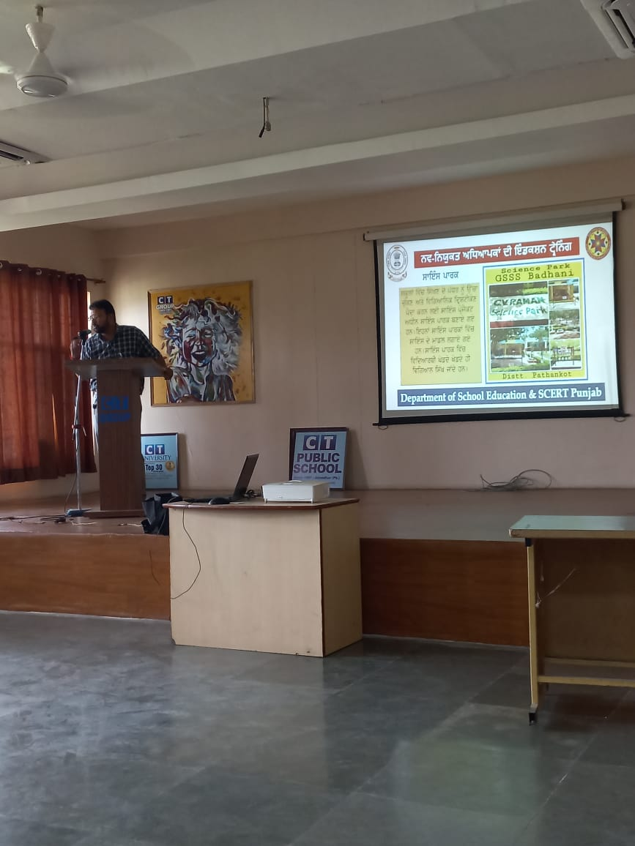
Guest lecture on 21st century Pedagogy Skills

Slide 40
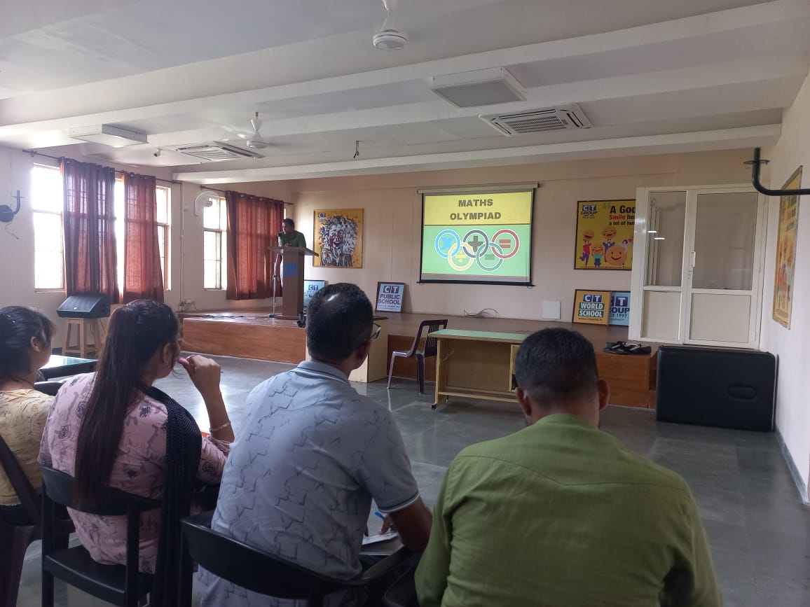

Slide 41
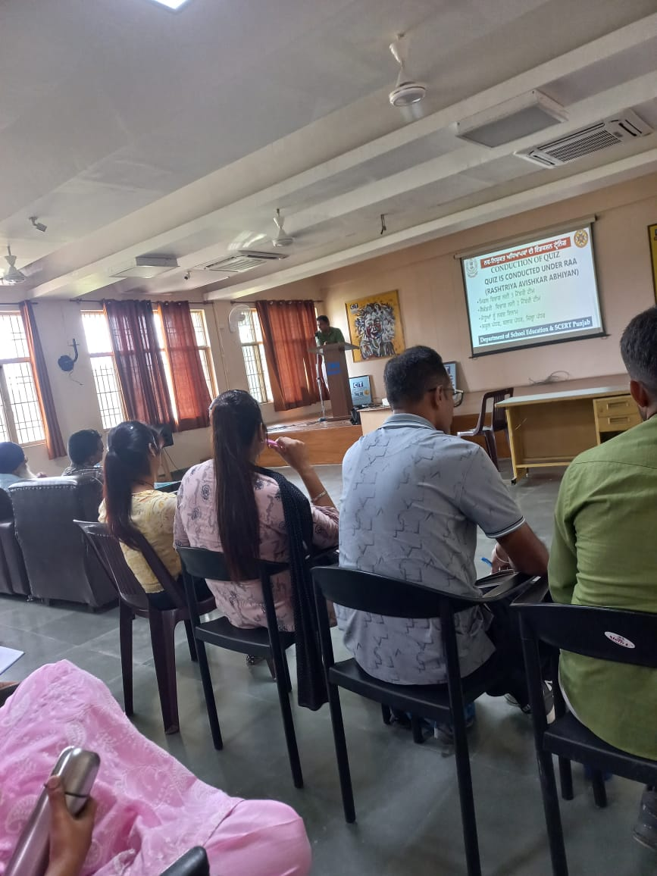

Slide 42
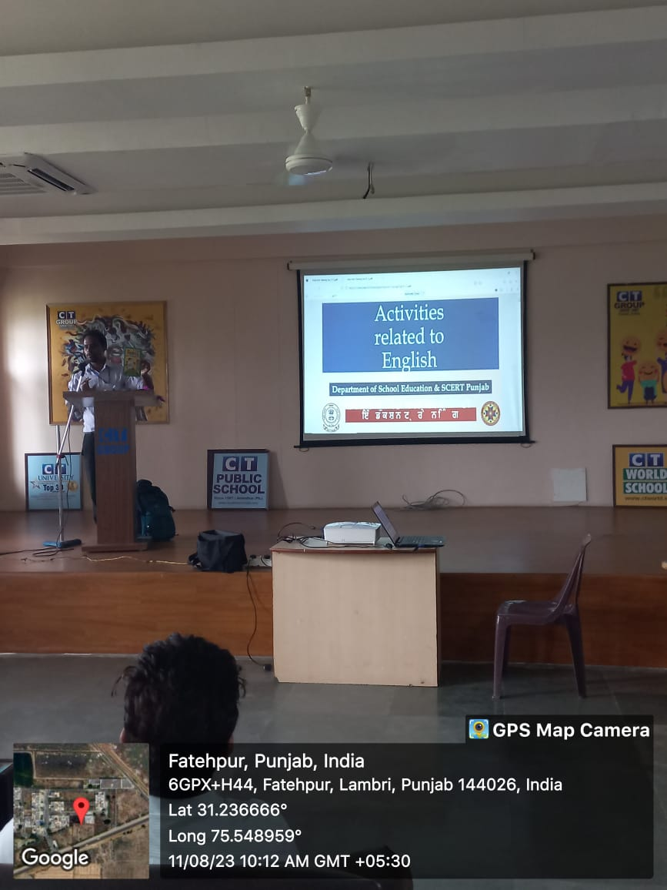

Slide 43
M. K. College of Education recently hosted an enlightening guest lecture on "21st Century Pedagogy Skills," featuring esteemed resource persons from reputed schools. The speakers passionately highlighted innovative teaching techniques for subjects like Mathematics, English, Social Science, and Science. Emphasizing the importance of adapting to contemporary educational needs, they delved into the incorporation of digital tools and e-platforms, providing valuable insights into navigating the evolving landscape of education. This engaging session empowered educators with fresh perspectives and practical strategies for fostering effective learning experiences in the 21st century.

Slide 44
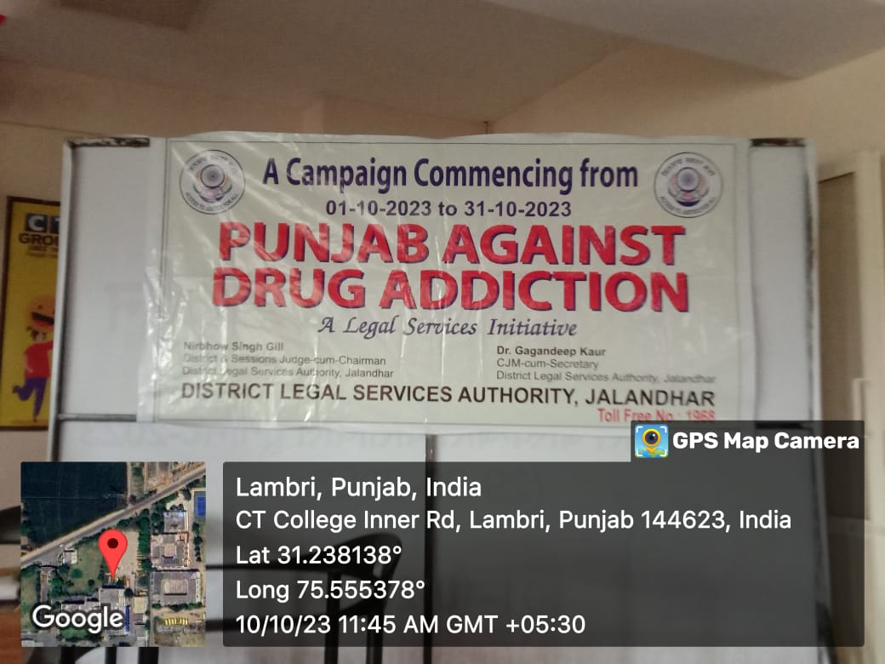
Awareness Campaign on Drug addiction

Slide 45
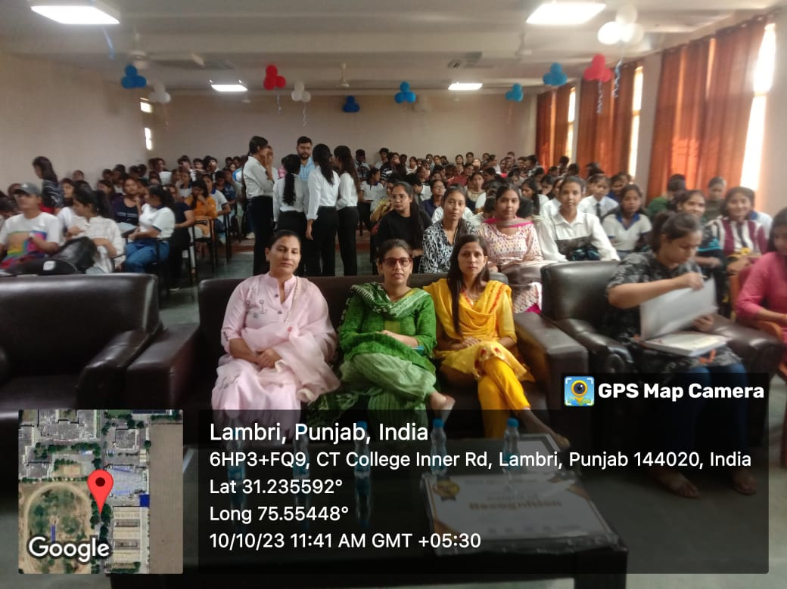

Slide 46
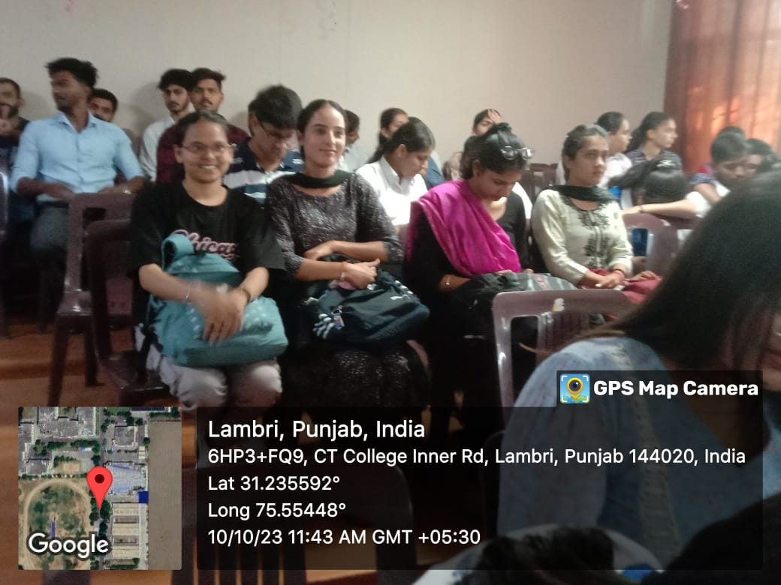

Slide 47
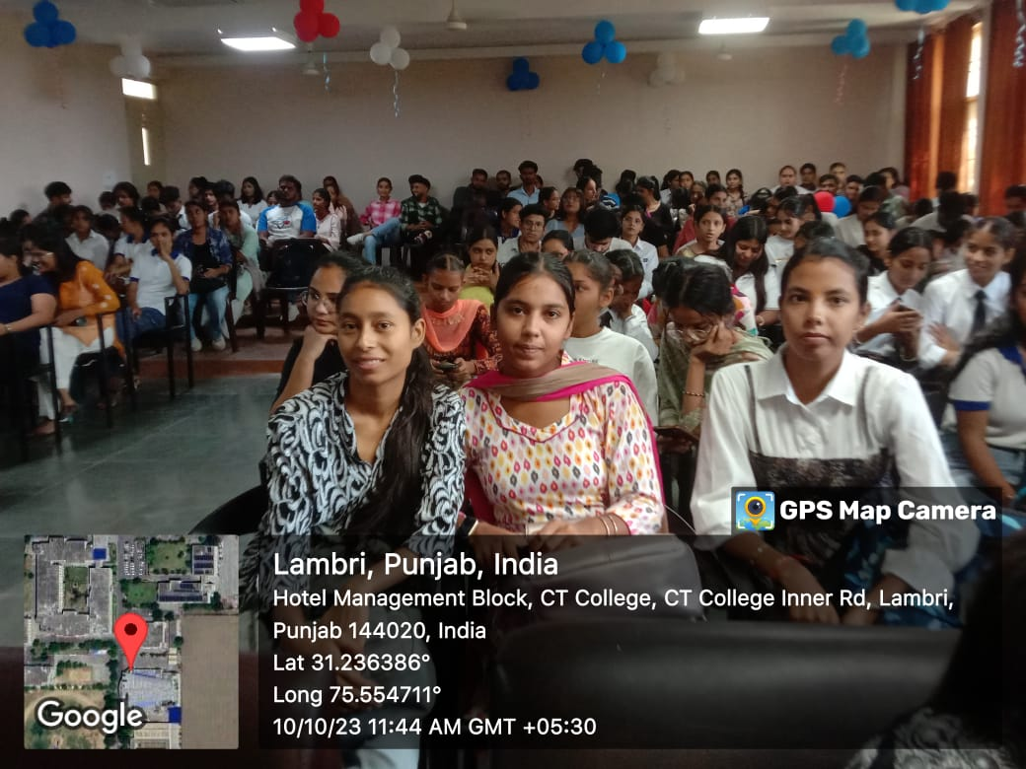

Slide 48
Our campus recently hosted a vital Awareness Campaign on Drug Addiction, a collective effort to address a pressing societal issue. The event aimed to educate students about the dangers of substance abuse and its impact on physical and mental well-being. This initiative not only heightened awareness but also underscored our commitment to creating a supportive, drug-free environment within our educational community.

Slide 49
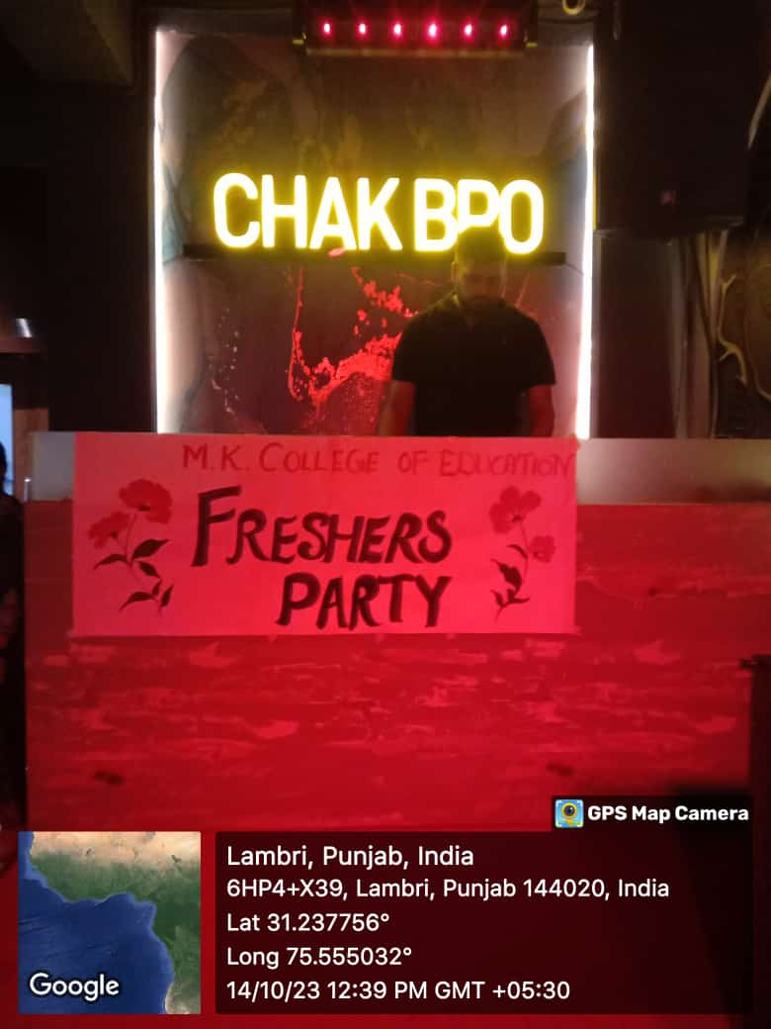
Fresher party

Slide 50


Slide 51


Slide 52
The vibrant Fresher's Party for our 1st-year students unfolded at the lively venue, Chakk Bro, creating unforgettable memories. The air was filled with excitement as students embraced the festivities, dancing and reveling in the lively atmosphere. The event not only provided a platform for students to unwind but also fostered a sense of companionship, marking the beginning of their academic journey with joy and enthusiasm.

